Slide 1
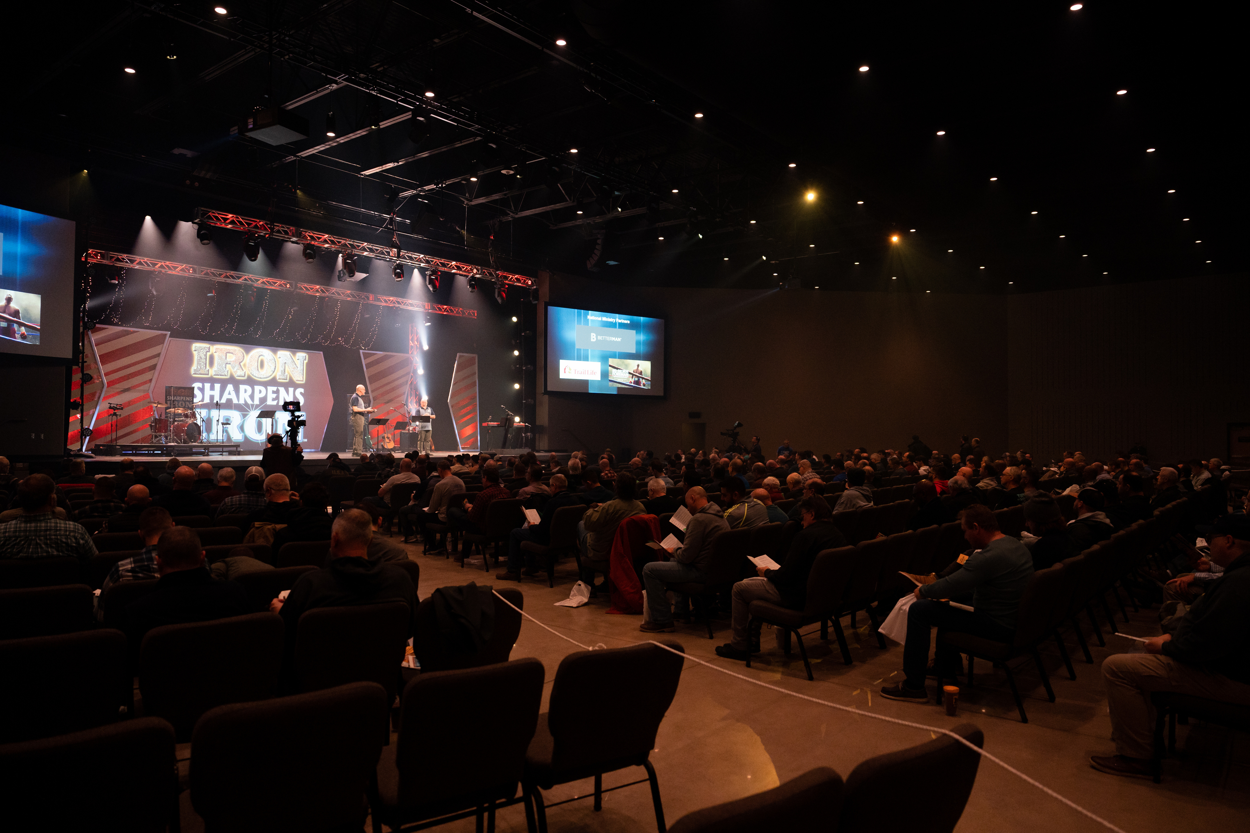

Rochester
Men’s
Equipping
Conference
Saturday, October 26th

Slide 2
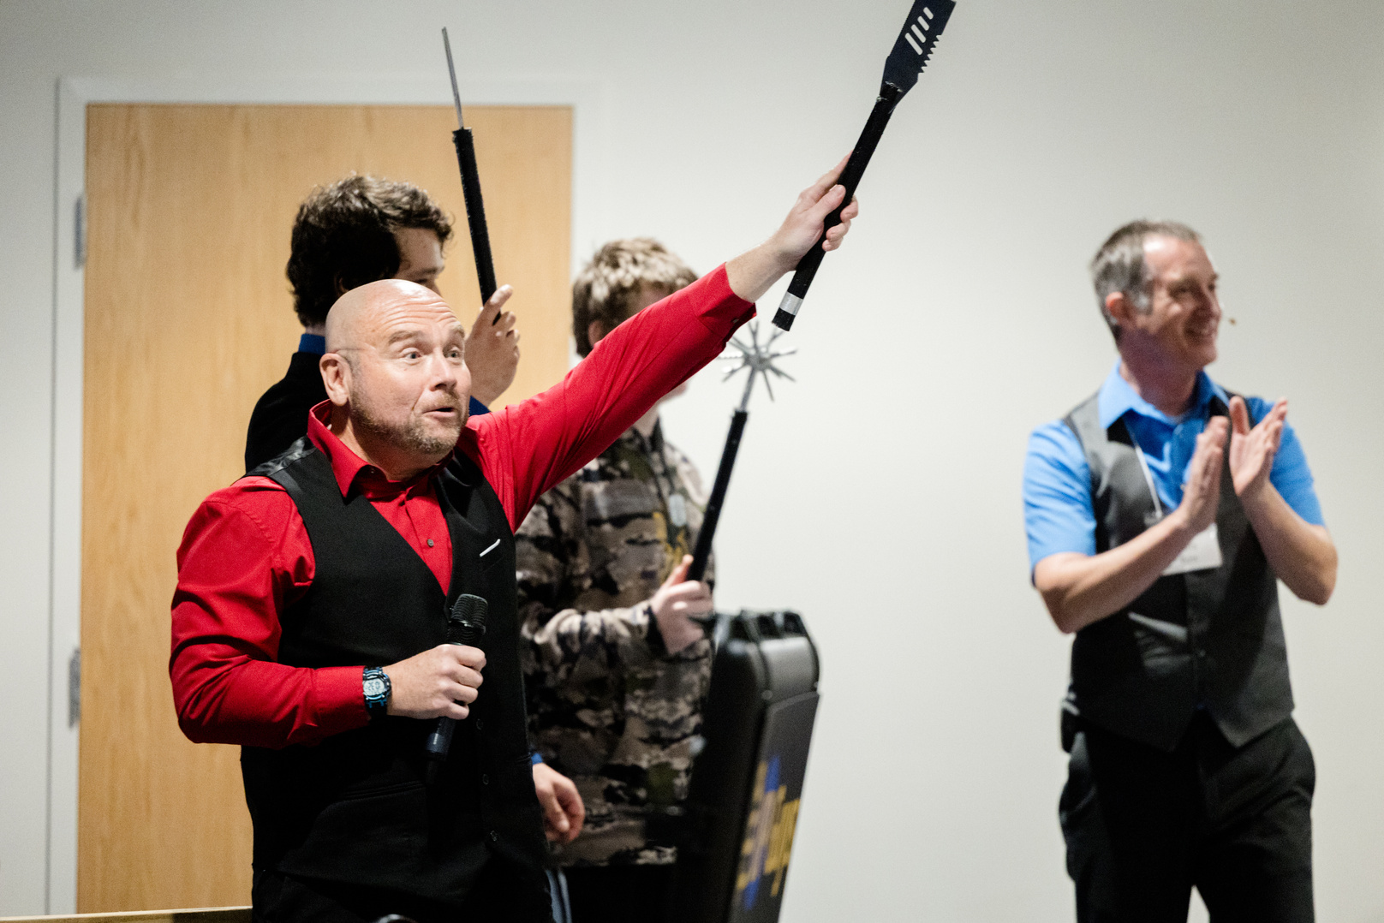
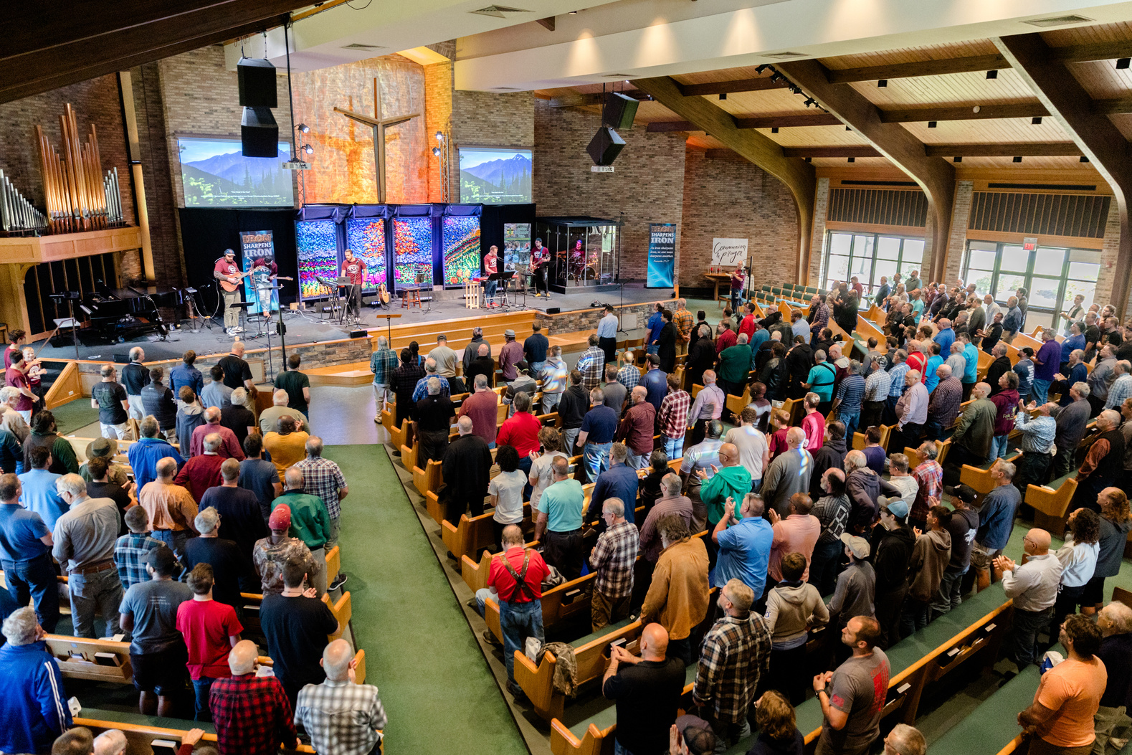
Men’s Equipping Conference
WORSHIP with hundreds of men from all over the region!
CHOOSE from 16 different equipping seminars
VISIT with expert presenters and exhibitors
EQUIP yourself with resources from local and national minitries

Slide 3
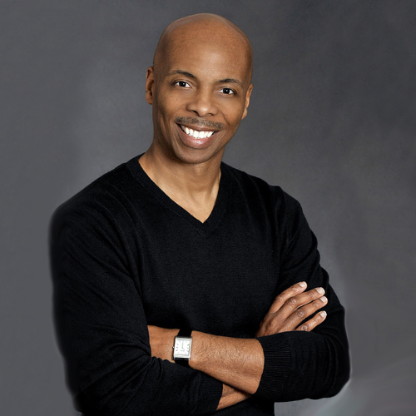
Keynote Speakers
Dr. Johnny Parker is a relationship architect who helps couples build marriages that flourish. He has been a national speaker for Family Life’s “Weekend to Remember” marriage conferences and chaplain of the Washington Redskins and Washington Mystics. Johnny and his wife have served as relationship coaches to the Pittsburgh Steelers players and their wives. They help professional athletes cultivate healthy lives and strong relationships.

Slide 4
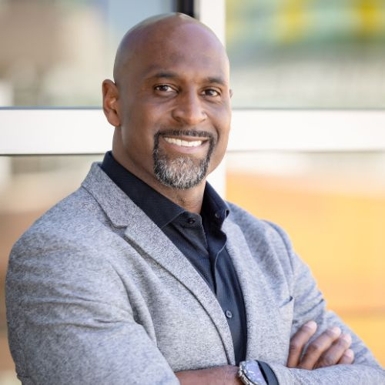
Keynote Speakers
Don Davis is an 11 year NFL veteran and two-time Super Bowl champion who uses his experience to minister to athletes. After his retirement from the Patriots, he joined their team as a strength and conditioning coach and chaplain. He later followed the Lord’s calling to full time ministry.
A devoted husband and loving father, his prayer is that through humility, honesty, transparency and authenticity, all will see God shining through him on a daily basis.

Slide 5
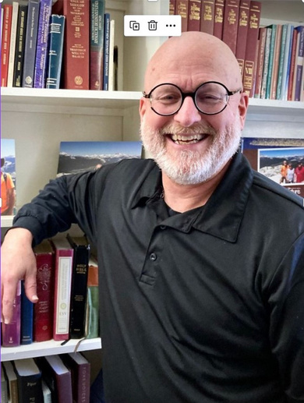
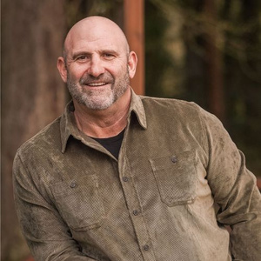
Men’s Equipping Conference
Saturday, October 26th
Hope Church
1301 Vintage Ln., Rochester, NY
Keynote Speakers
Tim Alexander
Jim Ramos
16 Seminar Options,
Resources from Dozens of Ministries,
& Hundreds of Men with One Mission!
Johnny Parker
Don Davis
REGISTER WITH THE MEN OF THIS CHURCH FOR $52

Slide 6
Morning Seminars
1. Are You Stuck in a Rut in the Battle for Purity?
Rob Stoddard, Church Outreach Specialist, Covenant Eyes, Mt. Pleasant, MI
2. Fathers as Priests
Steve Demme, Founder, Building Faith and Family, Lititz, PA
3. Intentional Christian Grandfathers
George Posthumus, Associate Director, Legacy Coalition, Dallas, TX
*For Seasoned Men (ages 55+)
4. Don’t Trade Future Blessings for Temporary Pleasures
Don Davis, Reverend, Pro Athletes Outreach, Bradenton, FL
*For Emerging & Pioneering Men (ages 13-29)

Slide 7
Morning Seminars
5. Leading Men – Are They Different?
Wendell Morton, Executive Director, Men’s Ministry Catalyst, Littleton, CO
6. Digital Cocaine: A Journey Toward iBalance
Brad Huddleston, Leader, Brad Huddleston Ministries, Stuarts Draft, VA
7. Strong Men Dangerous Times
Jim Ramos, President & Founder, Men in the Arena, McMinnville, OR
8. TBA

Slide 8
Afternoon Seminars
1. Dialed In: Reaching Your Full Capacity as a Man of God
Jim Ramos, President & Founder, Men in the Arena, McMinnville, OR
2. “Old Timothy”
Tim Alexander, Pastor, Perinton Community Church, Perinton, NY
*For Pastors & Seasoned Men (ages 55+)
3. Digital Rehab: Learning to Live Again in the Real World
Brad Huddleston, Leader, Brad Huddleston Ministries, Stuarts Draft, VA
*For Emerging & Pioneering Men (ages 13-29)
4. Putting Your Faith to Work
Ray Maser, The Chapel, Kenmore, NY

Slide 9
Afternoon Seminars
5. Become a Rescuer of Lost Souls
Nick Costello, Evangelist, Nick Costello Evangelistic Ministries, Rochester, NY
6. From Crisis to Christ, the Journey of a Husband and Father
Steve Demme, Founder, Building Faith and Family, Lititz, PA
7. Where Faith and Depression Meet
Paul Decker, Pastor, Campus Ambassadors, Amherst, NY
8. Becoming a 10x Better Man
Johnny Parker, CEO, The Parker Group LLC, Beltsville, MD

Slide 10
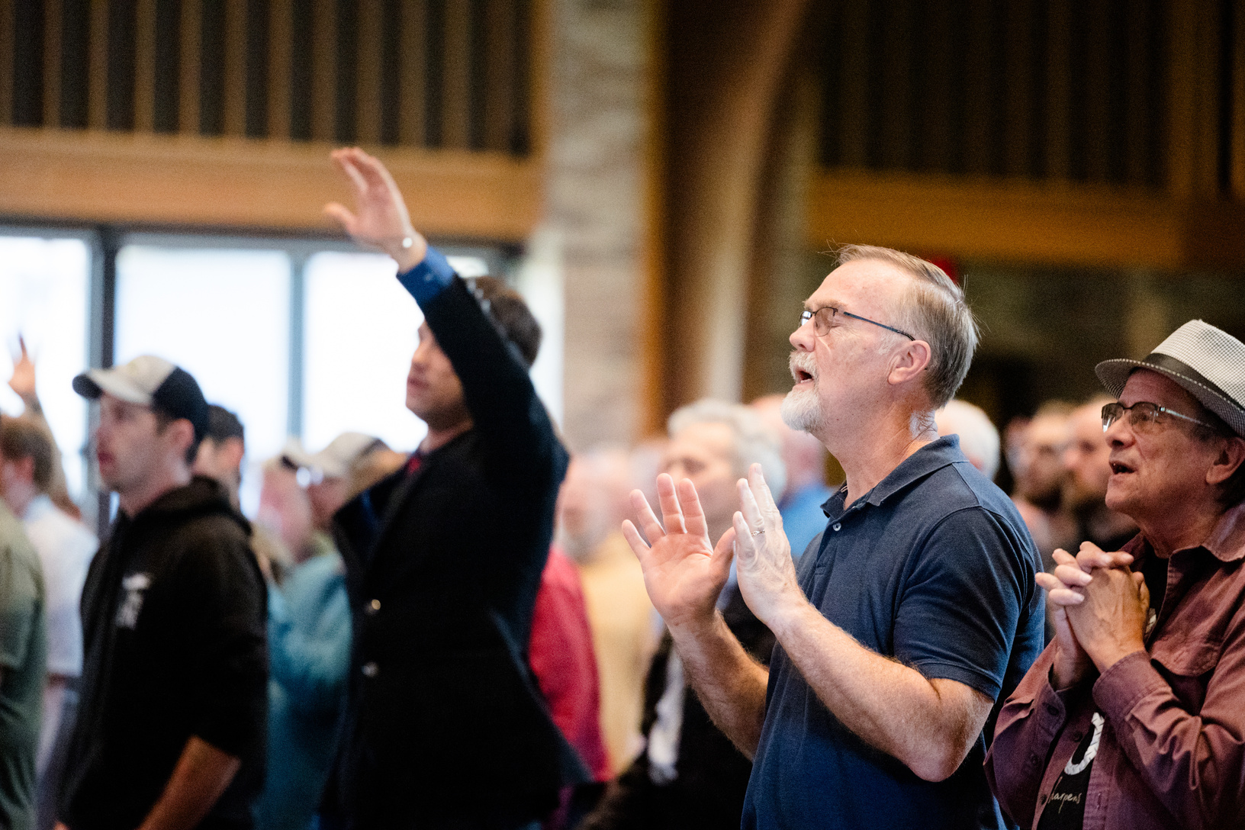
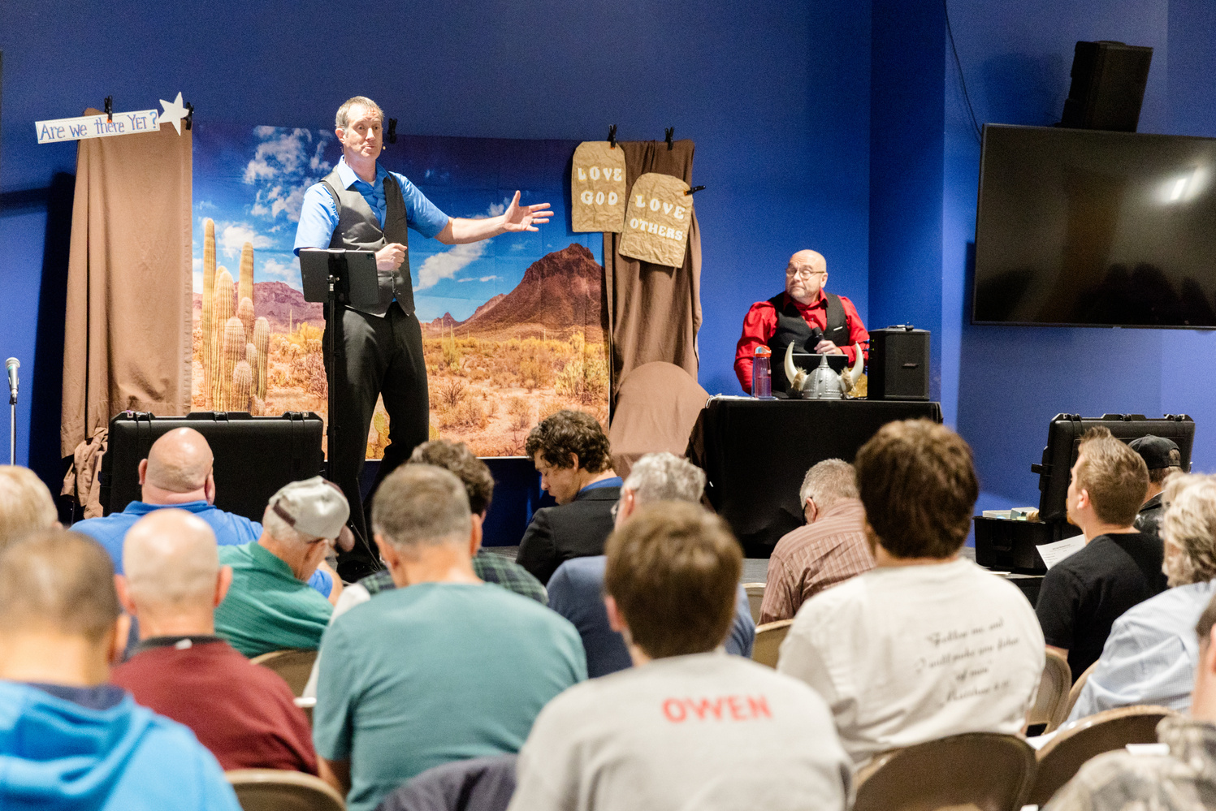
Men’s Equipping Conference
Saturday, October 26th
Hope Church
1301 Vintage Ln., Rochester, NY
Doors Open @ 7:30 am for Fellowship
Conference Begins @ 8:30
Conference Ends @ 3:30
ROCHESTERISI.COM
REGISTER WITH THE MEN OF THIS CHURCH FOR $52

