Slide 1
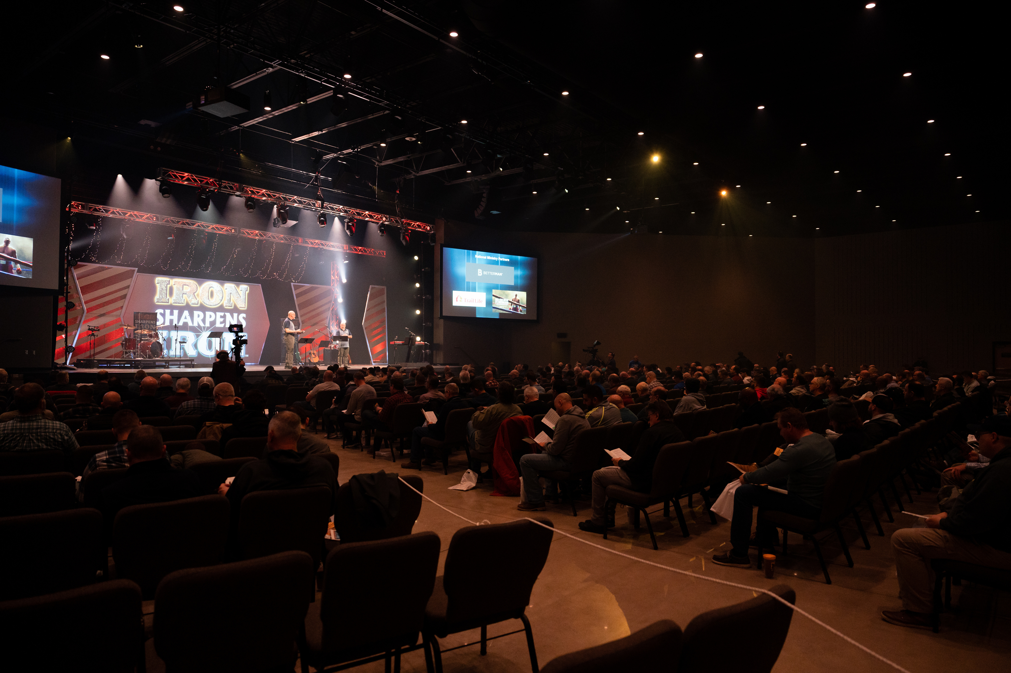

Buffalo
Men’s
Equipping
Conference
Saturday, March 15th

Slide 2
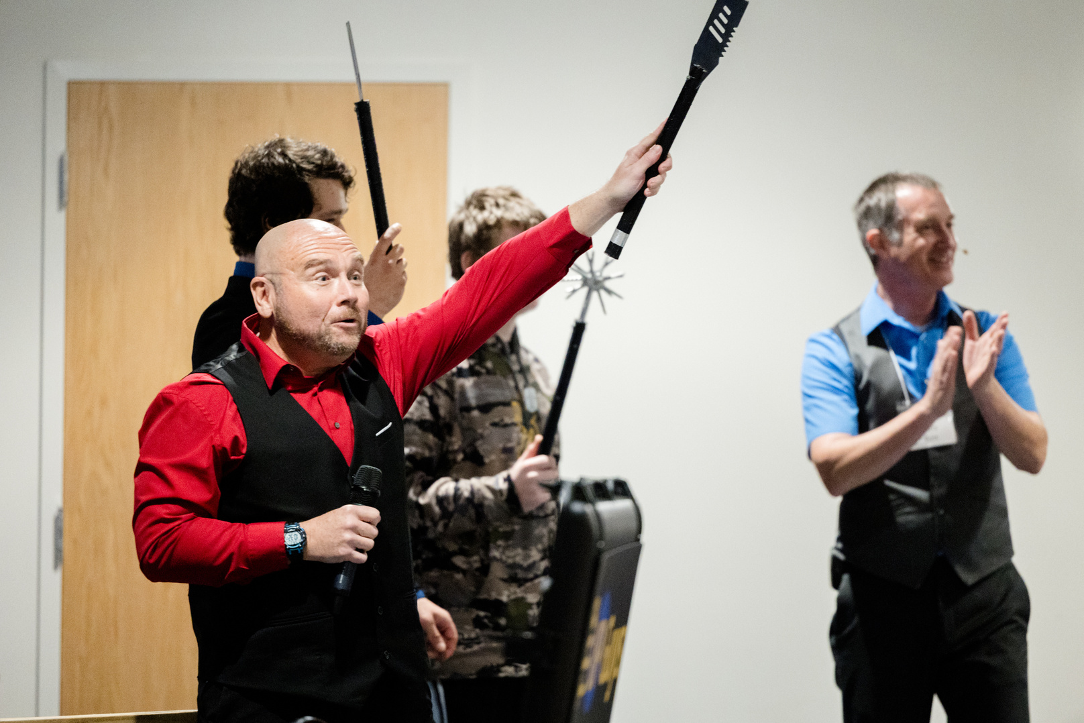
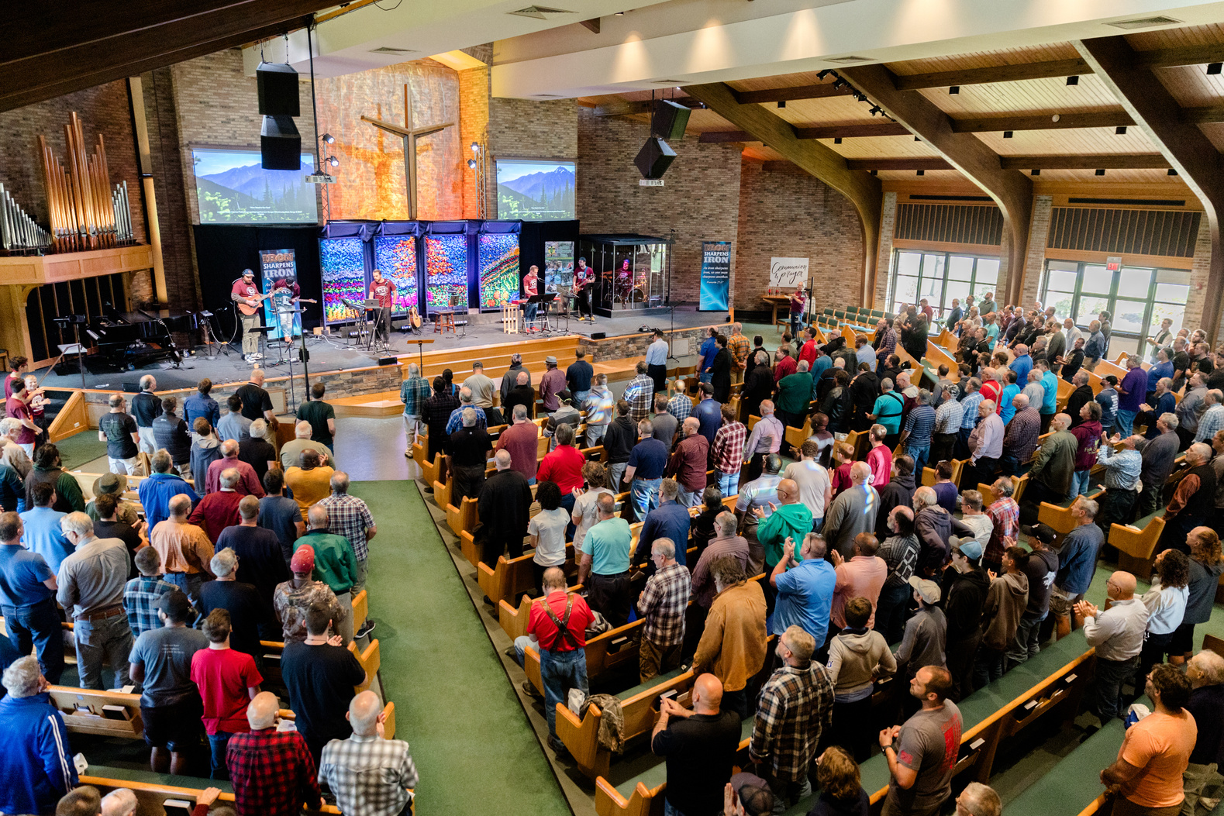
Men’s Equipping Conference
WORSHIP with hundreds of men from all over the region!
CHOOSE from 16 different equipping seminars
VISIT with expert presenters and exhibitors
EQUIP yourself with resources from local and national minitries

Slide 3
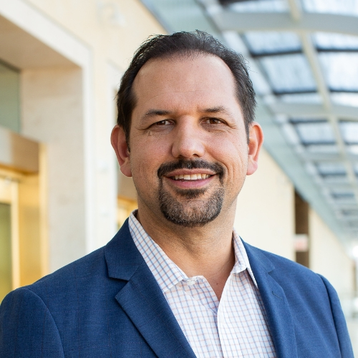
Keynote Speakers
Abdu Murrary is a speaker, author, and attorney specializing in the intersection and collision of faith with emerging cultural trends. Having written four books and nationally published articles, he tackles complex issues through forums, debates, and dialogue at leading universities across the country. In 2004 Abdu founded Embrace the Truth, a ministry committed to offering the credibility of the gospel to everyone who has questions. He also challenges believers that we must conform our conduct to model the character of Jesus.

Slide 4
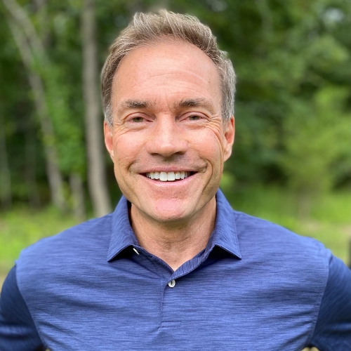
Keynote Speakers
Jeff Kemp is a former NFL quarterback and author of Facing the Blitz: Three Strategies for Turning Trials Into Triumphs and Receive: The Way of Jesus for Men. He is the son of Jack Kemp, former NFL quarterback and Vice-Presidential candidate. After 11 NFL seasons, Jeff retired to focus on his passion for families and seeing men become better friends, husbands, and fathers. He led Stronger Families, a non-profit dedicated to helping families thrive. Jeff also served as a V.P. at FamilyLife to support marriages, families, and churches.

Slide 5
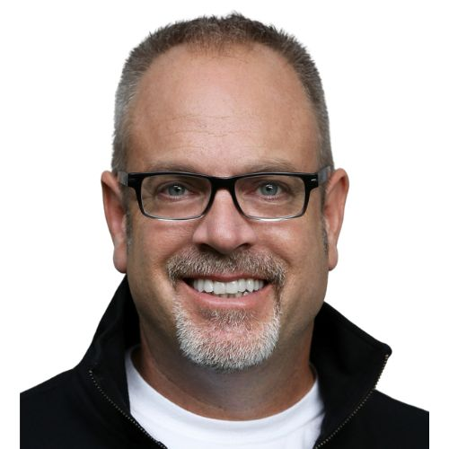
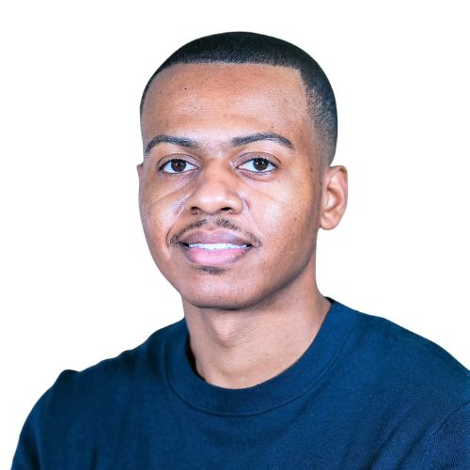
Men’s Equipping Conference
Saturday, March 15th
Revive Wesleyan
4999 McKinley Pkwy, Hamburg, NY
Keynote Speakers
David Dusek
Antoine Johnson
16 Seminar Options,
Resources from Dozens of Ministries,
& Hundreds of Men with One Mission!
Abdu Murray
Jeff Kemp
REGISTER WITH THE MEN OF THIS CHURCH FOR $52

Slide 6
Morning Seminars
1. Make It, Don’t Lose It
Ken Keeler, Real Financial Services, Calgary, AB
*For Emerging Men (ages 13-19)
2. Knowing and Understanding God’s Will
Butch Jerrell, MissionGO, Lockport, NY
3. How to Find Meaningful Relationships that Last
Jeff Frick, GRAM Ministry, Shelby Township, MI
4. 3 Do’s and 2 Don’ts for Single Fathers
Matt Haviland, Alpha Grand Rapids, Grand Rapids, MI

Slide 7
Morning Seminars
5. How to Transform Sinful Thoughts and Habits
Steve Etner, The Pure Man Ministry, Granger, IN
6. Anger: One Letter Away from Danger!
Larry Leak, Just Stand Firm Ministries, Wilbraham, MA
7. Improving Marriage as Investor Men
Jeff Kemp, Men Huddle, Little Rock, AR
8. Who Has Your Six: Forging Battle Ready Brotherhood
David Dusek, Rough Cut Men Ministries, Sarasota, FL

Slide 8
Afternoon Seminars
1. Forgiveness: Forgive While You Still Can
Larry Leak, Just Stand Firm Ministries, Wilbraham, MA
2. Better Fathers, Better Communities
Antoine Johnson, National Fatherhood Initiative, Buffalo, NY
*For Full Throttle Men (ages 30-54)
3. Stay in the Game
Ken Keeler, Real Financial Services, Calgary, AB
*For Seasoned Men (ages 55+)
4. Identifying Hidden Giants
Garrett Hall, Strengthen Ministries, Bath, NY

Slide 9
Afternoon Seminars
5. What’s Your Story? Overcoming Bad Belief System
David Dusek, Rough Cut Men Ministries, Sarasota, FL
*For Emerging Men (ages 13-19)
6. How to Enjoy God’s Word
Steve Etner, The Pure Man Ministry, Granger, IN
7. Clarity in the Culture of Confusion
Abdu Murray, Embrace the Truth, Rochester Hills, MI
8. T.B.A.

Slide 10
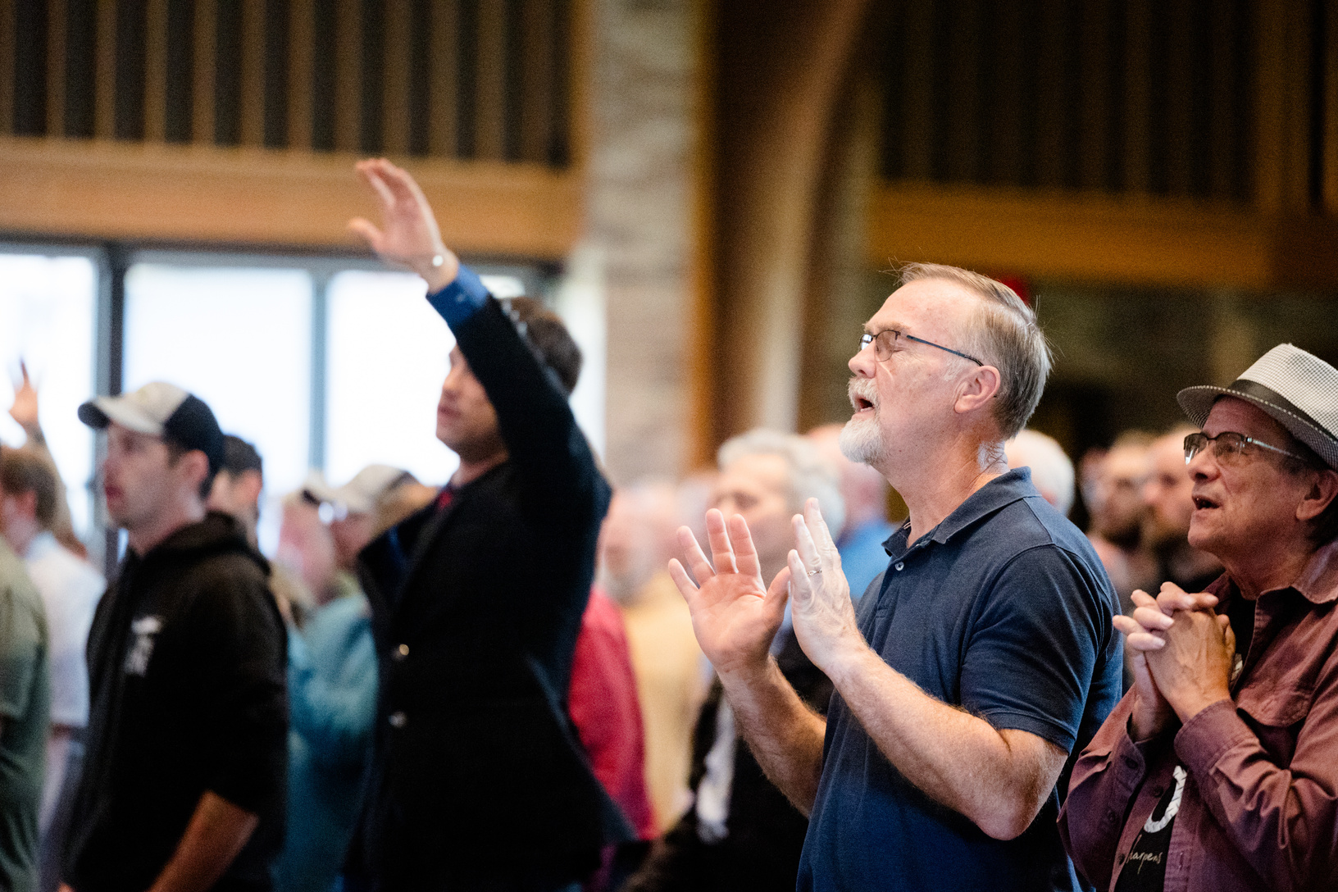
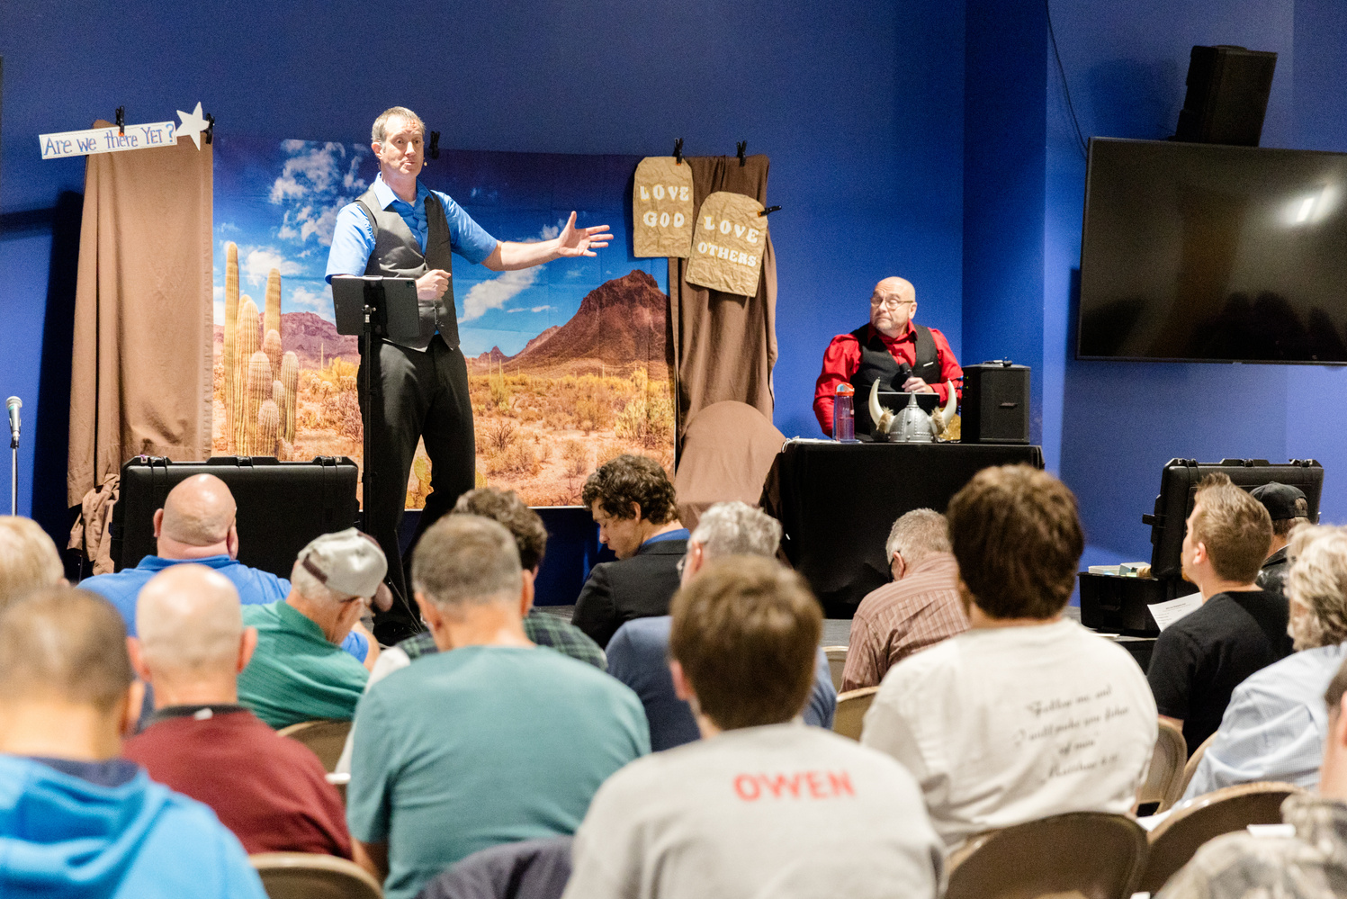
Men’s Equipping Conference
Saturday, March 15th
Revive Wesleyan
4999 McKinley Pkwy, Hamburg, NY
Doors Open @ 7:30 am for Fellowship
Conference Begins @ 8:30
Conference Ends @ 3:30
BuffaloISI.COM
REGISTER WITH THE MEN OF THIS CHURCH FOR $52

