Slide 1
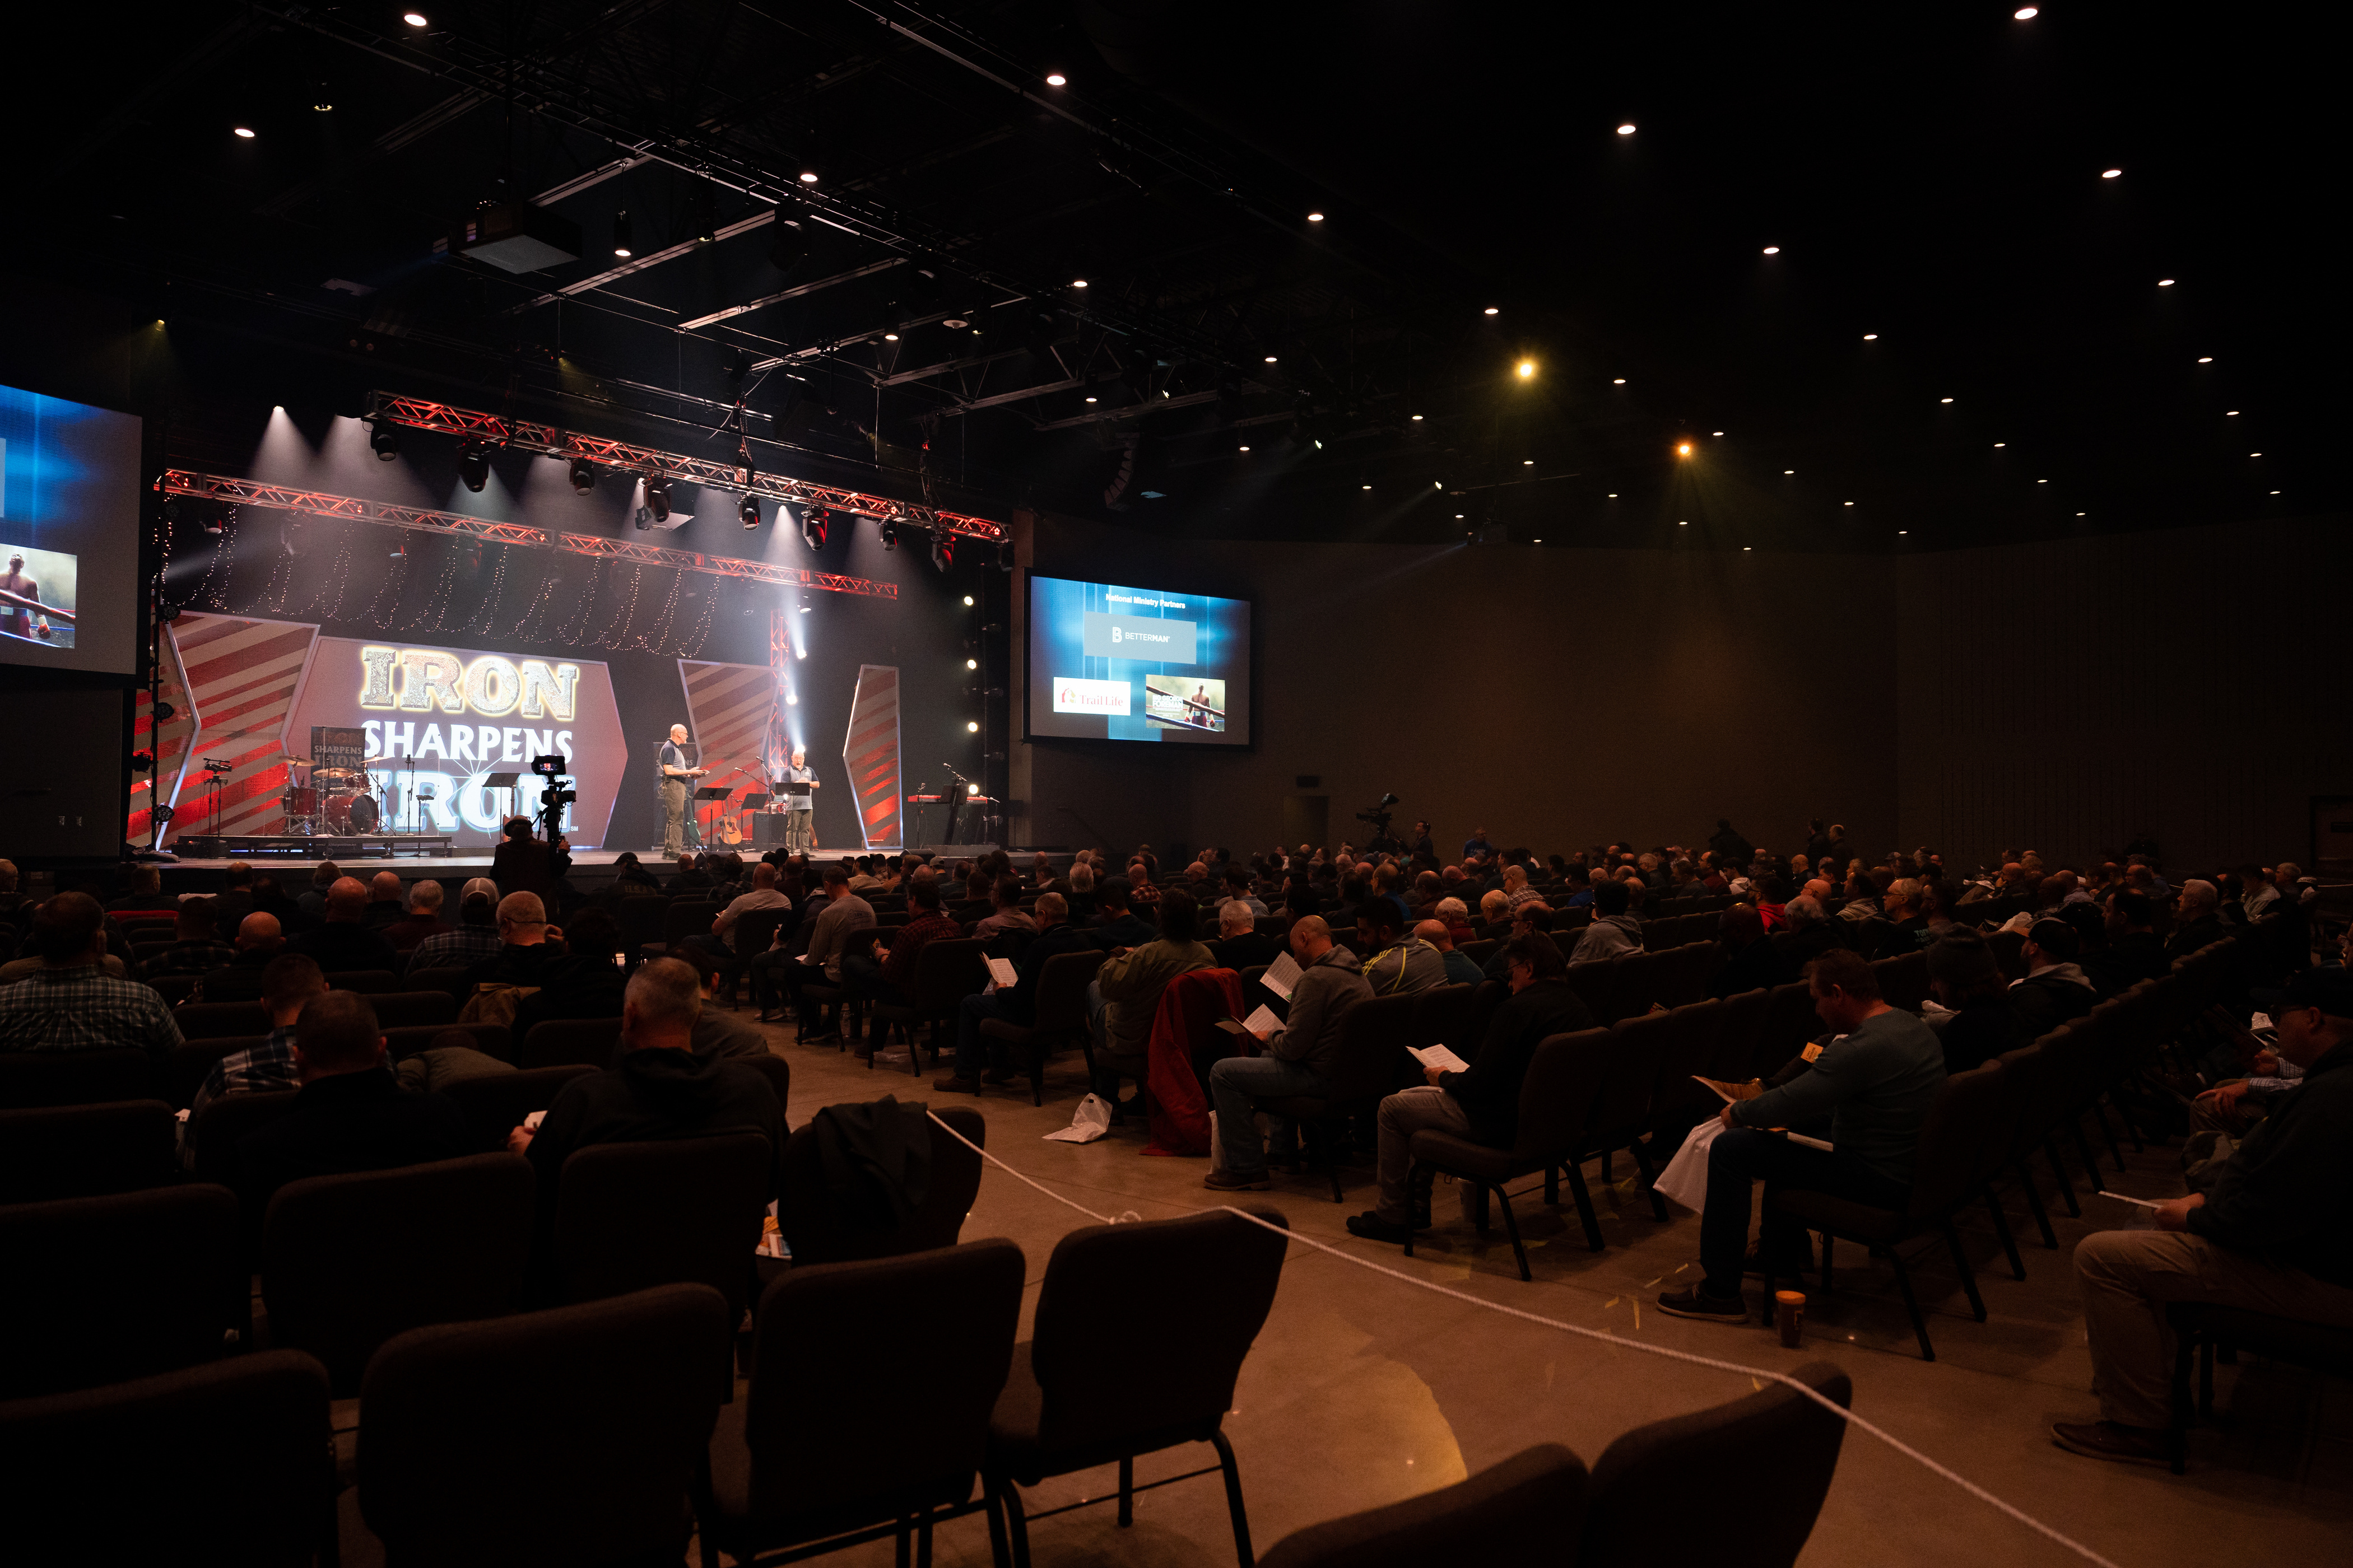

Rochester
Men’s
Equipping
Conference
Saturday, October 25th

Slide 2
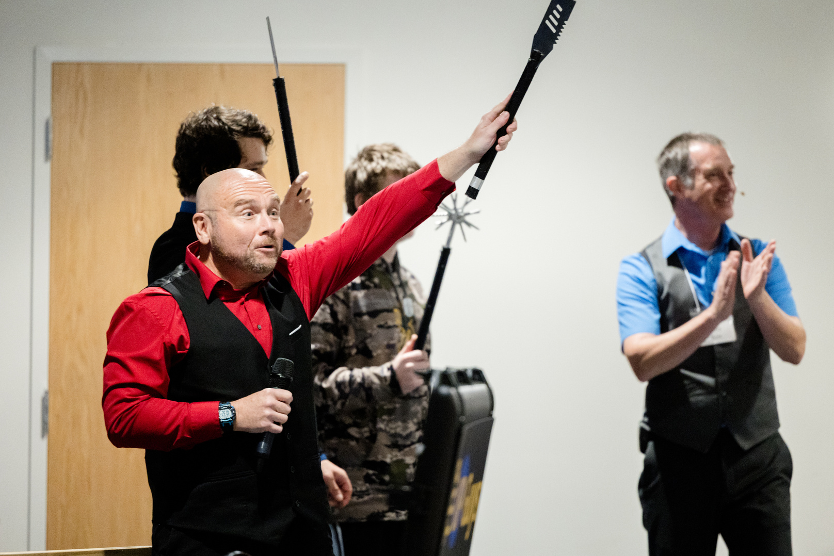
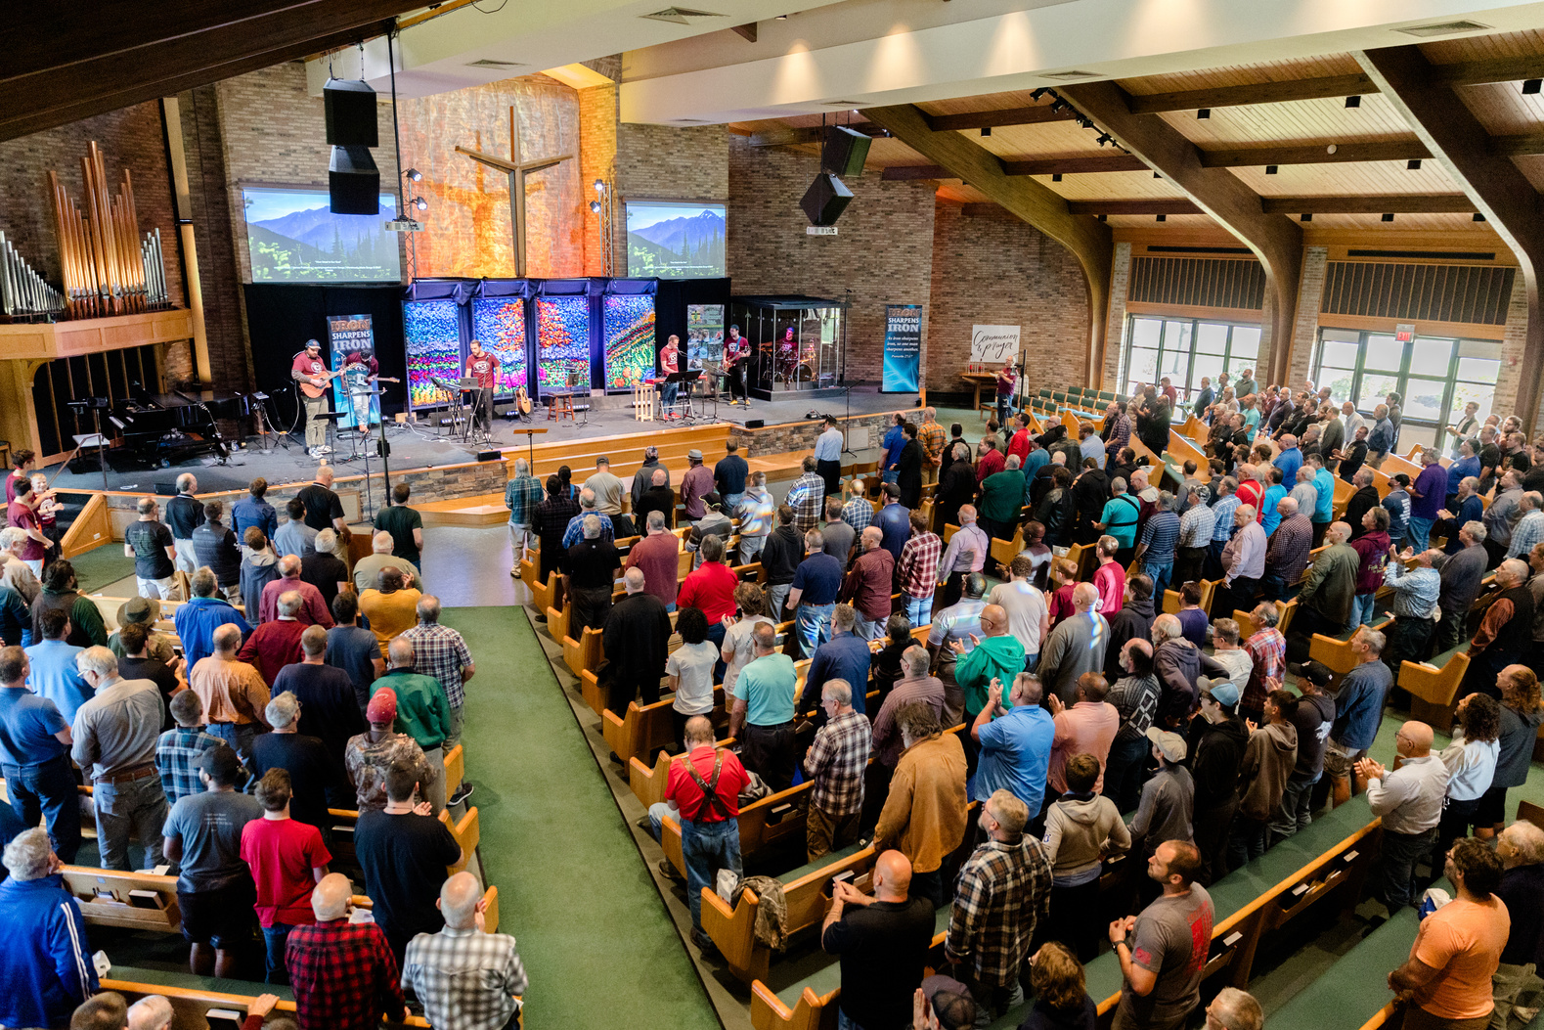
Men’s Equipping Conference
WORSHIP with hundreds of men from all over the region!
CHOOSE from 16 different equipping seminars
VISIT with expert presenters and exhibitors
EQUIP yourself with resources from local and national ministries

Slide 3
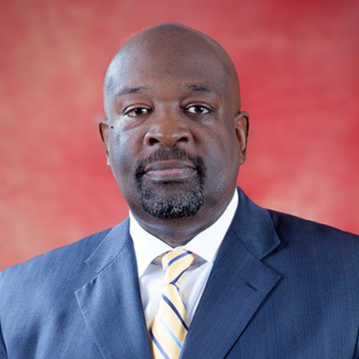
Keynote Speakers
William Clark is founder and co-director of Kingdom Reign Ministries, a dynamic regional network devoted to church planting, leadership development, and community transformation. His passion for building strong leadership cultures also led to establish The Fellowship Network, a national community of pastors and ministry leaders dedicated to fostering encouragement, accountability, and support.
Married to Toni for over 43 years, they faithfully pastored New Bethel Community Church in Buffalo for 27 years.

Slide 4
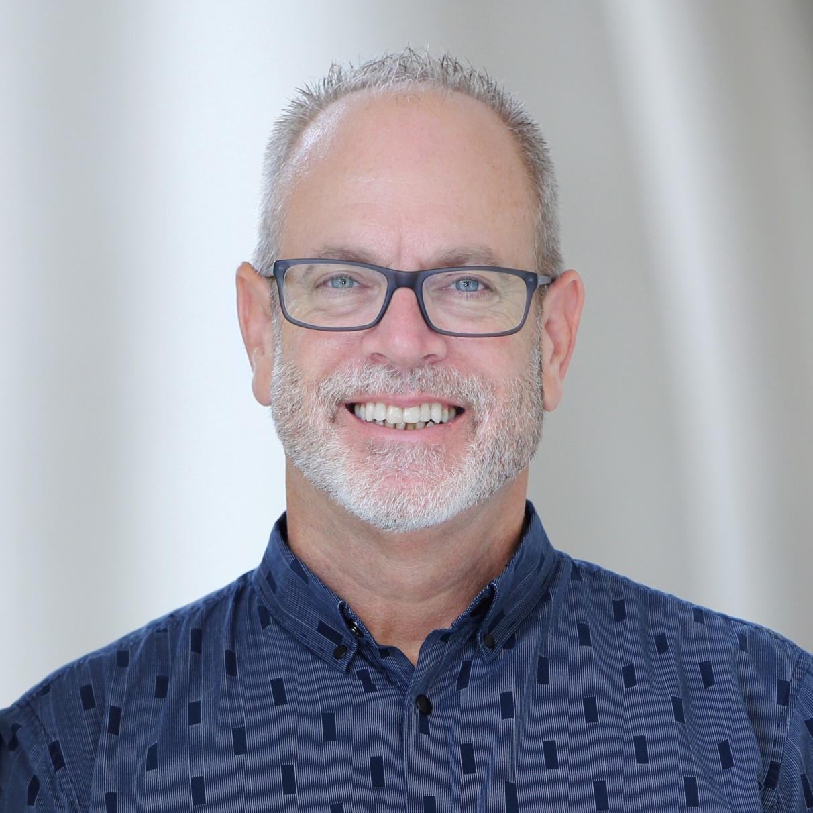
Keynote Speakers
David is the founder of Rough Cut Men Ministries and author of the Amazon #1 best-selling “Rough Cut Men: A Man’s Battle Guide to Building Real Relationships with Other Men, and with Jesus”.
David speaks internationally and has presented at West Point, the US Naval Academy, and dozens of other Army installations in the US, Korea, and Germany. He has been a keynote speaker at both Promise Keepers in New Zealand and Iron Sharpens Iron Conferences in the US.
A native of Florida, David resides in Sarasota, Florida with his wife Joni.

Slide 5
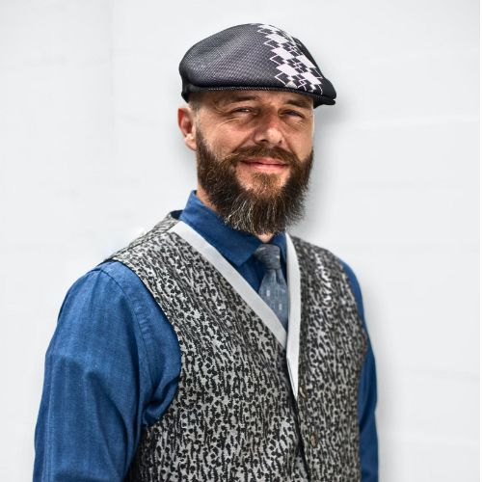
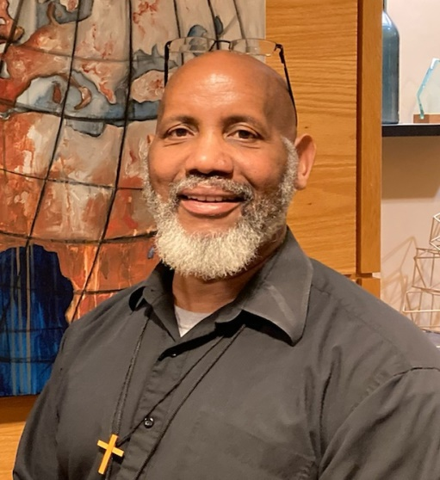

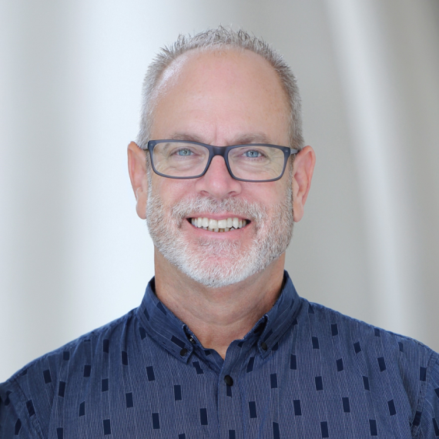
Men’s Equipping Conference
Saturday, October 25th
Hope Church
1301 Vintage Ln, Rochester, NY
Keynote Speakers
Wailer Giles
John Thomas
16 Seminar Options,
Resources from Dozens of Ministries,
& Hundreds of Men with One Mission!
Bill Clark
David Dusek
REGISTER WITH THE MEN OF THIS CHURCH FOR $57

Slide 6
Morning Seminars #1
1. Faith at Work
Tom DiJohn, Kingdom Factor, NY
2. Helping Men Succeed in Life
John Thomas, Every Man a Warrior, PA
3. Battle: Lessons for Biblical Manhood Learned from Combat
David Dusek, Rough Cut Men, FL
4. Transforming Addiction
Chris Knapp, Freedom Expressions, NY

Slide 7
Morning Seminars #1
5. Nailing Your Colors to the Mast
Don Sunshine, Don Sunshine Ministries, TN
6. The Enemy in Our Camp
Wailer Giles, Proven Men, VA
7. Finding God’s Will for Your Life
Kevin Maloney, Grace Road Church, NY
*For Emerging Men (ages 13-19)
8. Rise Up: Reclaiming the Role of the Father
Robert Stein, Fathers in Christ, MI

Slide 8
Morning Seminars #2
1. Faith at Work
Tom DiJohn, Kingdom Factor, NY
2. Helping Men Succeed in Life
John Thomas, Every Man a Warrior, PA
3. The Purpose of the Bible
Ralph Essery, NY
4. Transforming Addiction
Chris Knapp, Freedom Expressions, NY

Slide 9
Morning Seminars #2
5. Nailing Your Colors to the Mast
Don Sunshine, Don Sunshine Ministries, TN
6. The Enemy in Our Camp
Wailer Giles, Proven Men, VA
7. Battle: Lessons for Biblical Manhood Learned from Combat
Dusek, Rough Cut Men, FL
8. Rise Up: Reclaiming the Role of the Father
Robert Stein, Fathers in Christ, MI

Slide 10
Afternoon Seminars
1. Make a Difference
Don Sunshine, Don Sunshine Ministries, TN
2. Sex & the Cornerstone of Men’s Discipleship
Wailer Giles, Proven Men, VA
3. Grandpas With a Plan
Sam Richbart, Camp Hickory Hill, NY
*For Seasoned Men (ages 55+)
4. The First & Greatest Commandment
Tom Fredericks, Every Man a Warrior, TN
*For Emerging Men (ages 13-19)

Slide 11
Afternoon Seminars
5. Kingdom Mindset: Win the War Within
Robert Stein, Fathers in Christ, MI
6. The Purpose of the Bible
Ralph Essery, NY
7. Financial Stewardship: Beyond the Basics
David Moore, The Financial Guys, NY
8. Next Level Husbands
William Clark, Bill & Toni Clark Ministries, NY

Slide 12
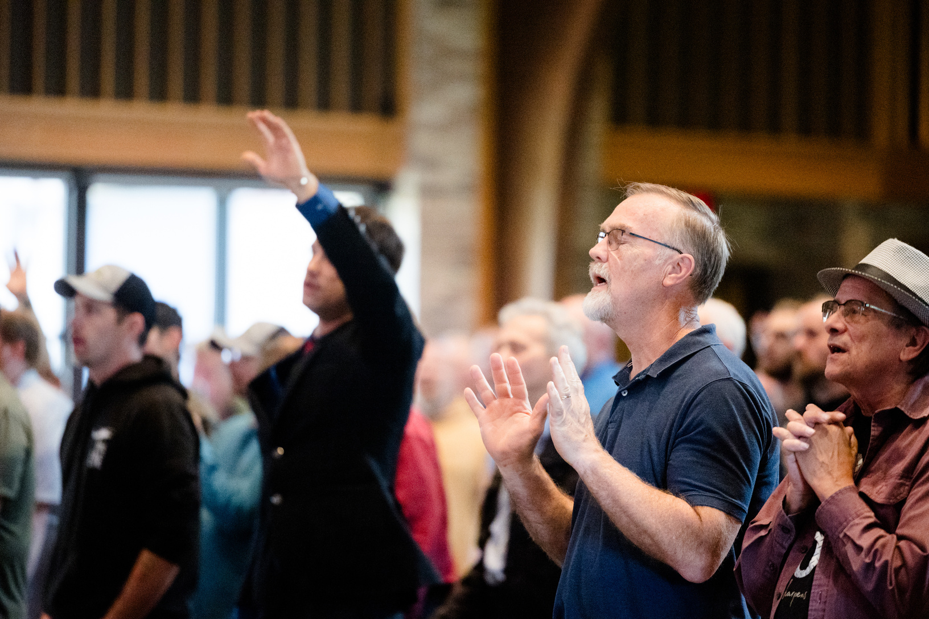
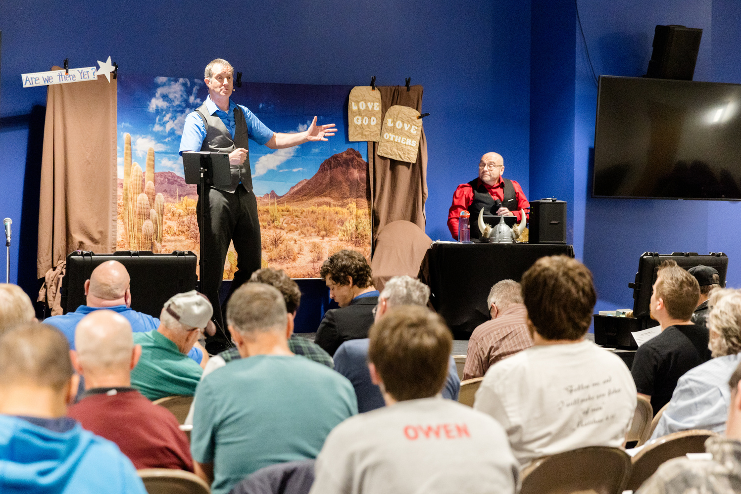
Men’s Equipping Conference
Saturday, October 25th
Hope Church
1301 Vintage Ln, Rochester, NY
Doors Open @ 7:30 am for Fellowship
Conference Begins @ 8:25
Conference Ends @ 4:00
RochesterISI.COM
REGISTER WITH THE MEN OF THIS CHURCH FOR $57

