Slide 1

Buffalo
Men’s
Equipping
Conference
Saturday, March 21st

Slide 2
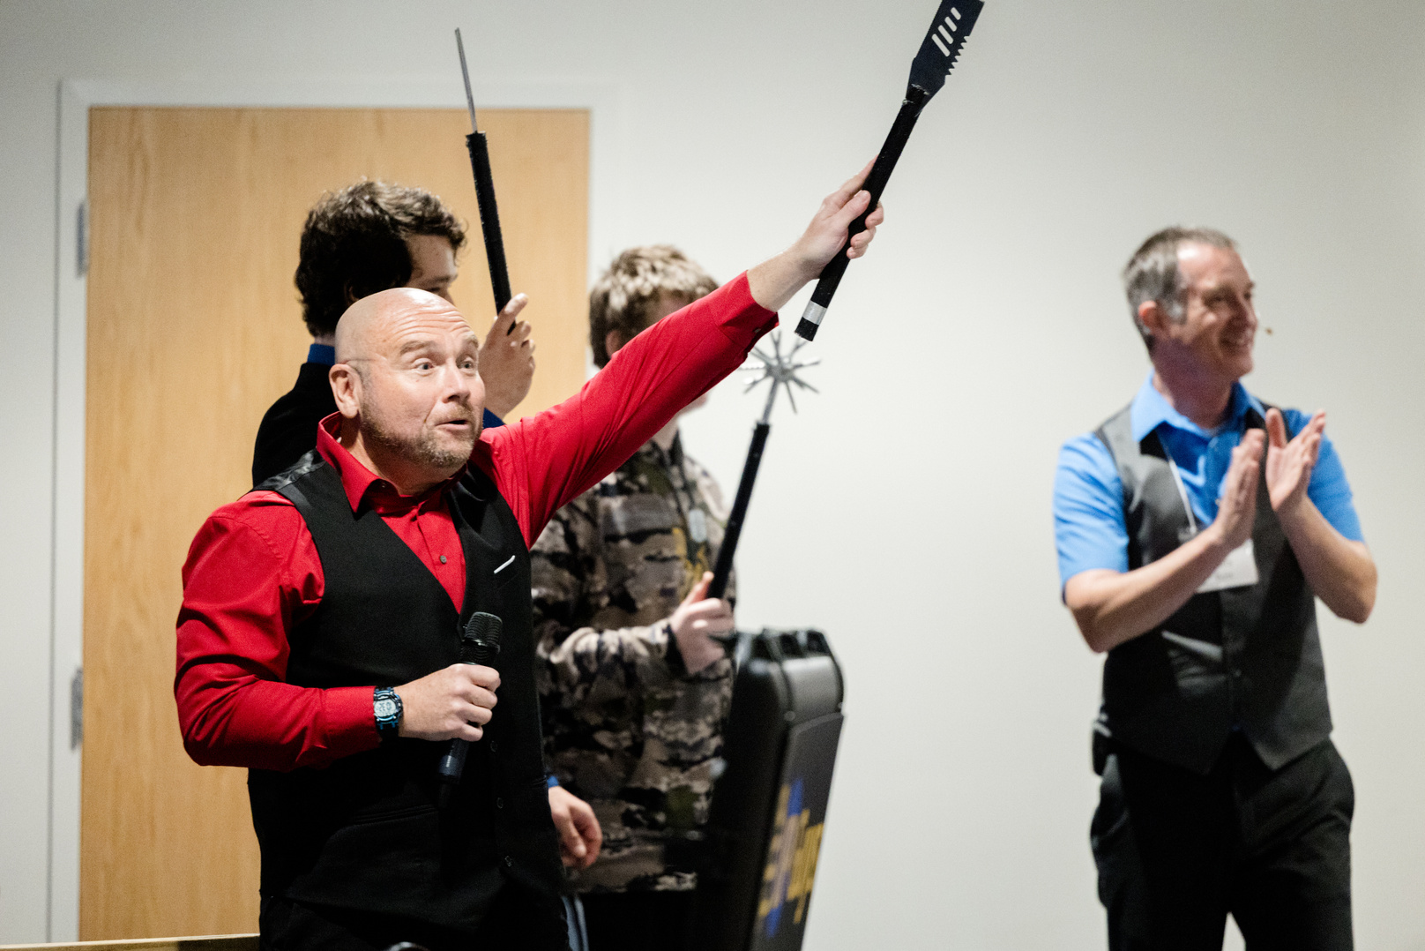
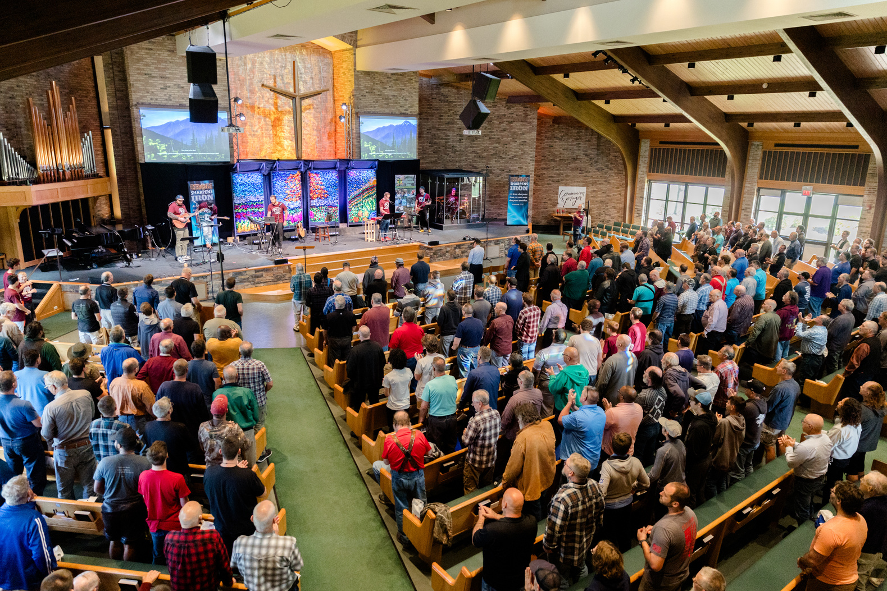
Men’s Equipping Conference
WORSHIP with hundreds of men from all over the region!
CHOOSE from 17 different equipping seminars
VISIT with expert presenters and exhibitors
EQUIP yourself with resources from local and national ministries

Slide 3
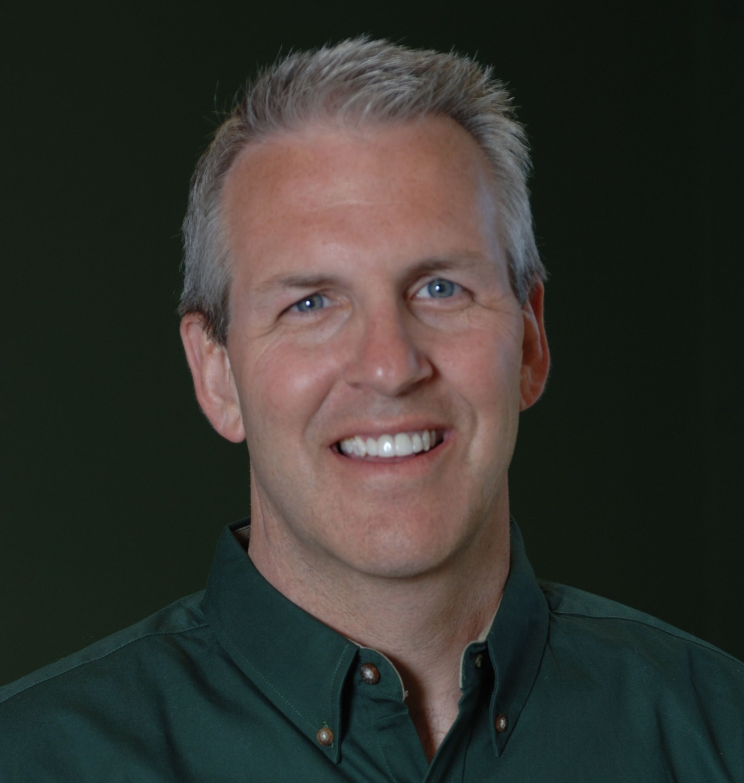
Keynote Speakers
Rod Handley is the Founder & President of Character That Counts, and also the co-founder of TGIW (“Teaching Gods Infinite Wisdom”). Today, TGIW groups are meeting all over the world.
Rod has published over 20 books including, Character Counts-Who’s Counting Yours? Rod is a popular retreat and banquet speaker with men’s and women’s groups, singles and married.
Rod and his wife, Janna, have been married over 25 years and they have four children, and reside in Lee’s Summit, Missouri.

Slide 4
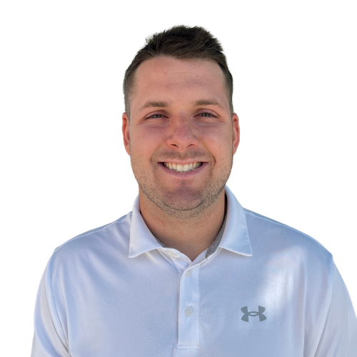
Keynote Speakers
Derek Handley is the Director of Ministry for Character That Counts. He is a passionate and engaging speaker and has a heartbeat for discipleship. Derek’s ministry focuses on men ages 20-40, shaped by Ezra 7:10, teaching men how to study the Word of God, holding them accountable to live it out, and equipping them to disciple others.
He has been married to his wife Mikala for seven years. They live in Lee’s Summit, MO with their two daughters and third child on the way.

Slide 5
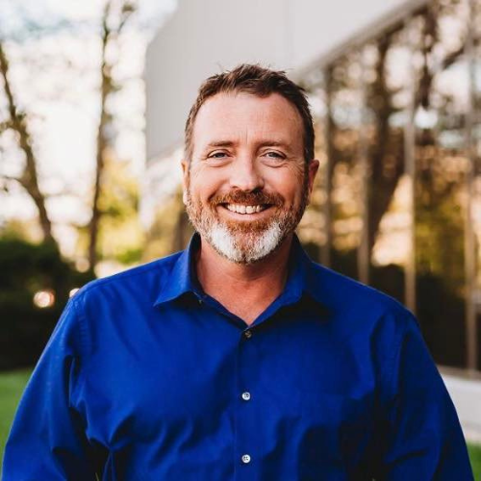
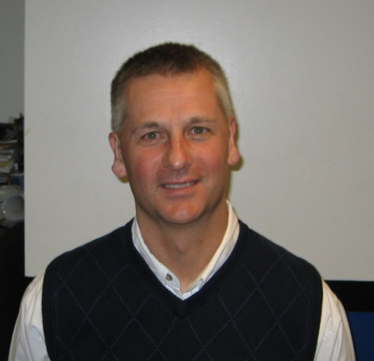

Men’s Equipping Conference
Saturday, March 21st
Revive Wesleyan
4999 McKinley Pkwy, Hamburg, NY
Keynote Speakers
Greg Mayo
Mike Masters
17 Seminar Options,
Resources from Dozens of Ministries,
& Hundreds of Men with One Mission!
Rod Handley
Derek Handley
REGISTER WITH THE MEN OF THIS CHURCH FOR $52

Slide 6
Morning Seminars
1. Connection is Critical
Don Manning, Crazy Cool Family, Argyle, TX
2. Building Unity by Equipping Men to Stand Against Divisive Agendas
Elmo Winters, Kingdom Group International, Baton Rouge, LA
3. The Marriage You’ve Always Wanted
Rob Thorpe, Marriages that Matter, Little Rock, AR
4. Creating Rooms of Grace
Dan Wobschall, Be Broken Ministries, Copperas Cove, TX

Slide 7
Morning Seminars
5. God Knows a Sincere Heart
Dan Kostrzebski, Gideons International, Madison, AL
6. 10 Kinds of Men Every Man Needs in His Life
Matt Haviland, Alpha Grand Rapids, Grand Rapids, MI
7. Mighty Men of Valor
Mike Masters, Cross Training Athletics, Lancaster, NY
*For Emerging Men (ages 13-19)
8. The 710 Method: Equipping Men to Study, Practice, and Teach
Derek Handley, STRATIA, Lee’s summit, MO

Slide 8
Morning Seminars
9. Reaching Wounded Men: The Abortion Conversation Churches Miss
Greg Mayo, Almost Daddy, Plainfield, IN
10. Principles of Effective Bible Study
Brian Stebick, Camp Hickory Hill, Varysburg, NY

Slide 9
Afternoon Seminars
1. It’s All About Relationships
Don Manning, Crazy Cool Family, Argyle, TX
*For Emerging Men (ages 13-19)
2. Fit for the Call: 7 Proven Steps to Renew Your Health
Elmo Winters, Kingdom Group International, Baton Rouge, LA
3. Capture the Heart of Your Teen
Mike Masters, Cross Training Athletics, Lancaster, NY
4. Enough is Enough – Learn to Walk in Freedom
Rob Thorpe, Marriages that Matter, Little Rock, AR

Slide 10
Afternoon Seminars
5. Accountability: The Missing Link
Rod Handley, Character that Counts, Lee’s Summit, MO
6. The Do’s and Don’ts of Single Fatherhood
Matt Haviland, Alpha Grand Rapids, Grand Rapids, MI
7. Discipleship Through the 12 Steps: Ancient Truth for Modern Brokenness
Greg Mayo, Almost Daddy, Plainfield, IN
8. Principles of Effective Bible Study
Brian Stebick, Camp Hickory Hill, Varysburg, NY

Slide 11
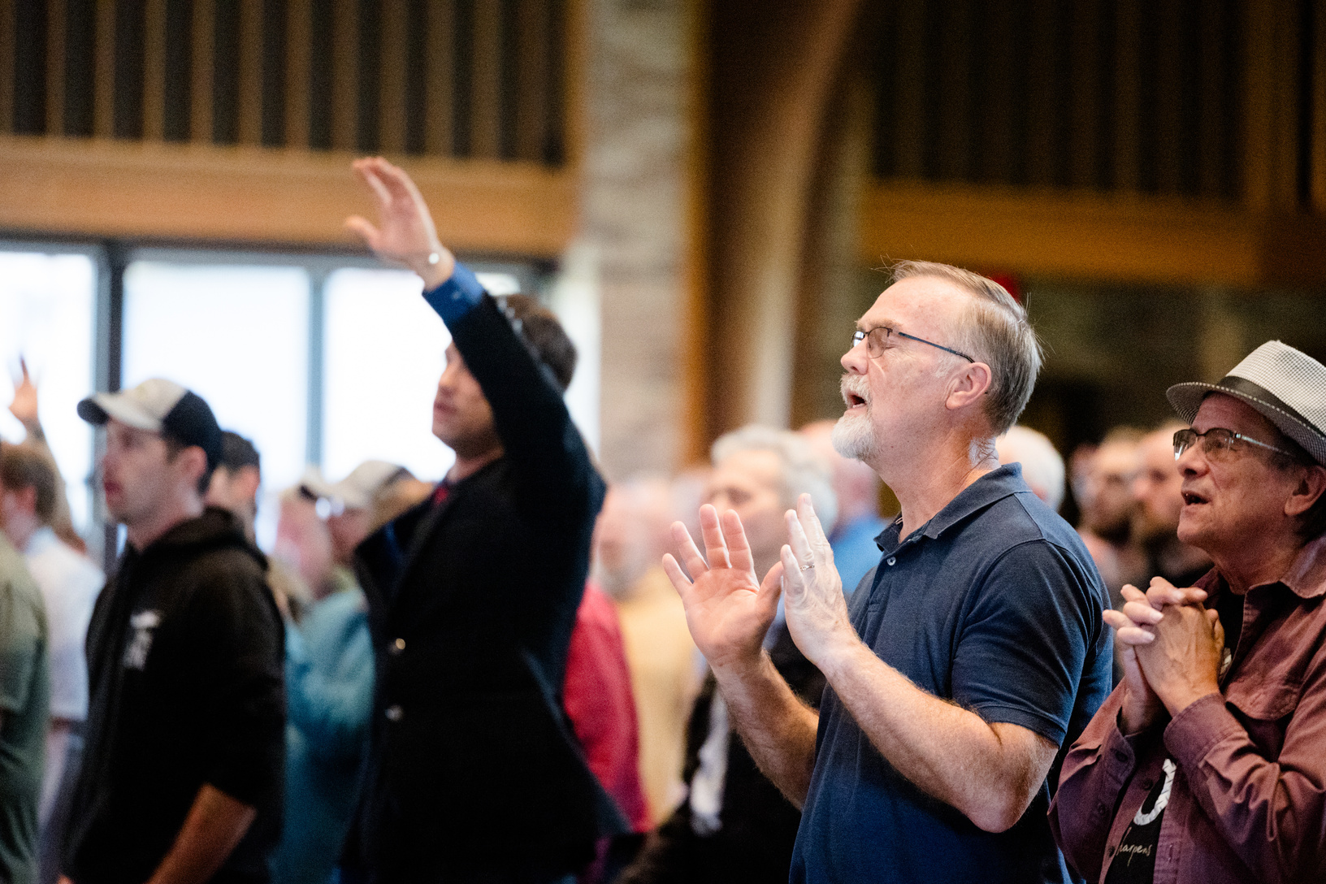
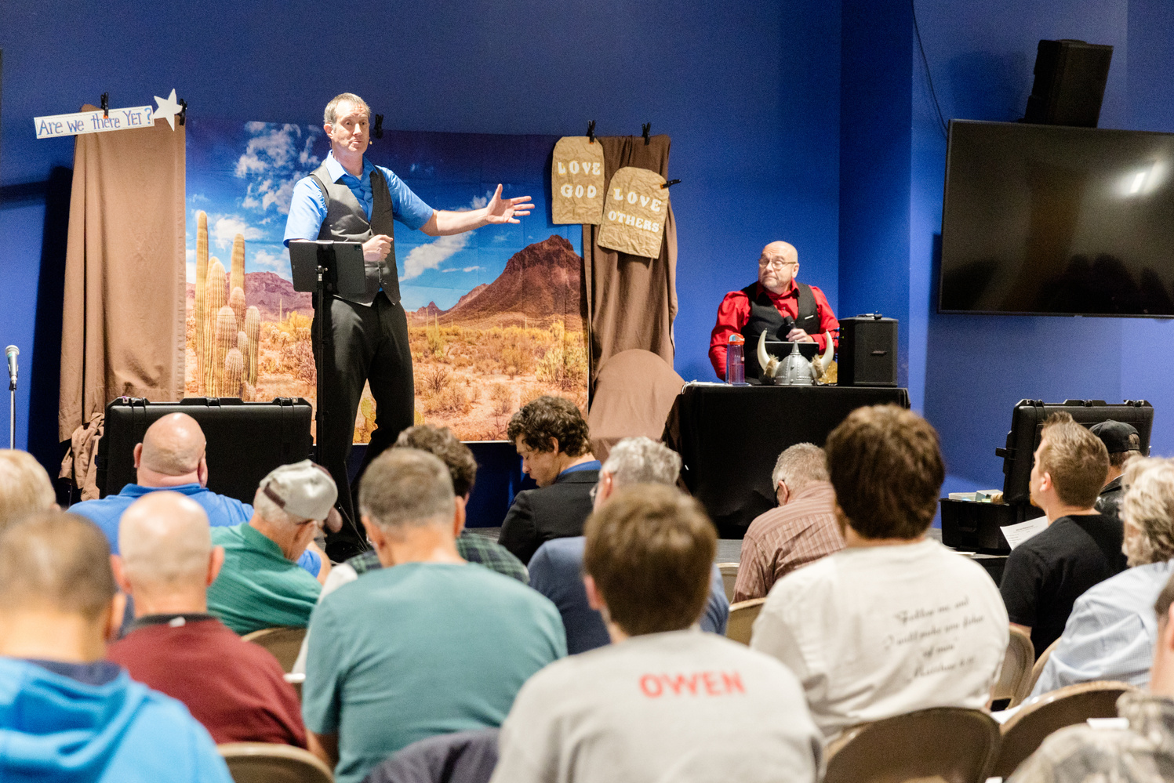
Men’s Equipping Conference
Saturday, March 21st
Revive Wesleyan
4999 McKinley Pkwy, Hamburg, NY
Doors Open @ 7:30 am for Fellowship
Conference Begins @ 8:25
Conference Ends @ 4:00
BuffaloISI.COM
REGISTER WITH THE MEN OF THIS CHURCH FOR $52

