Slide 1
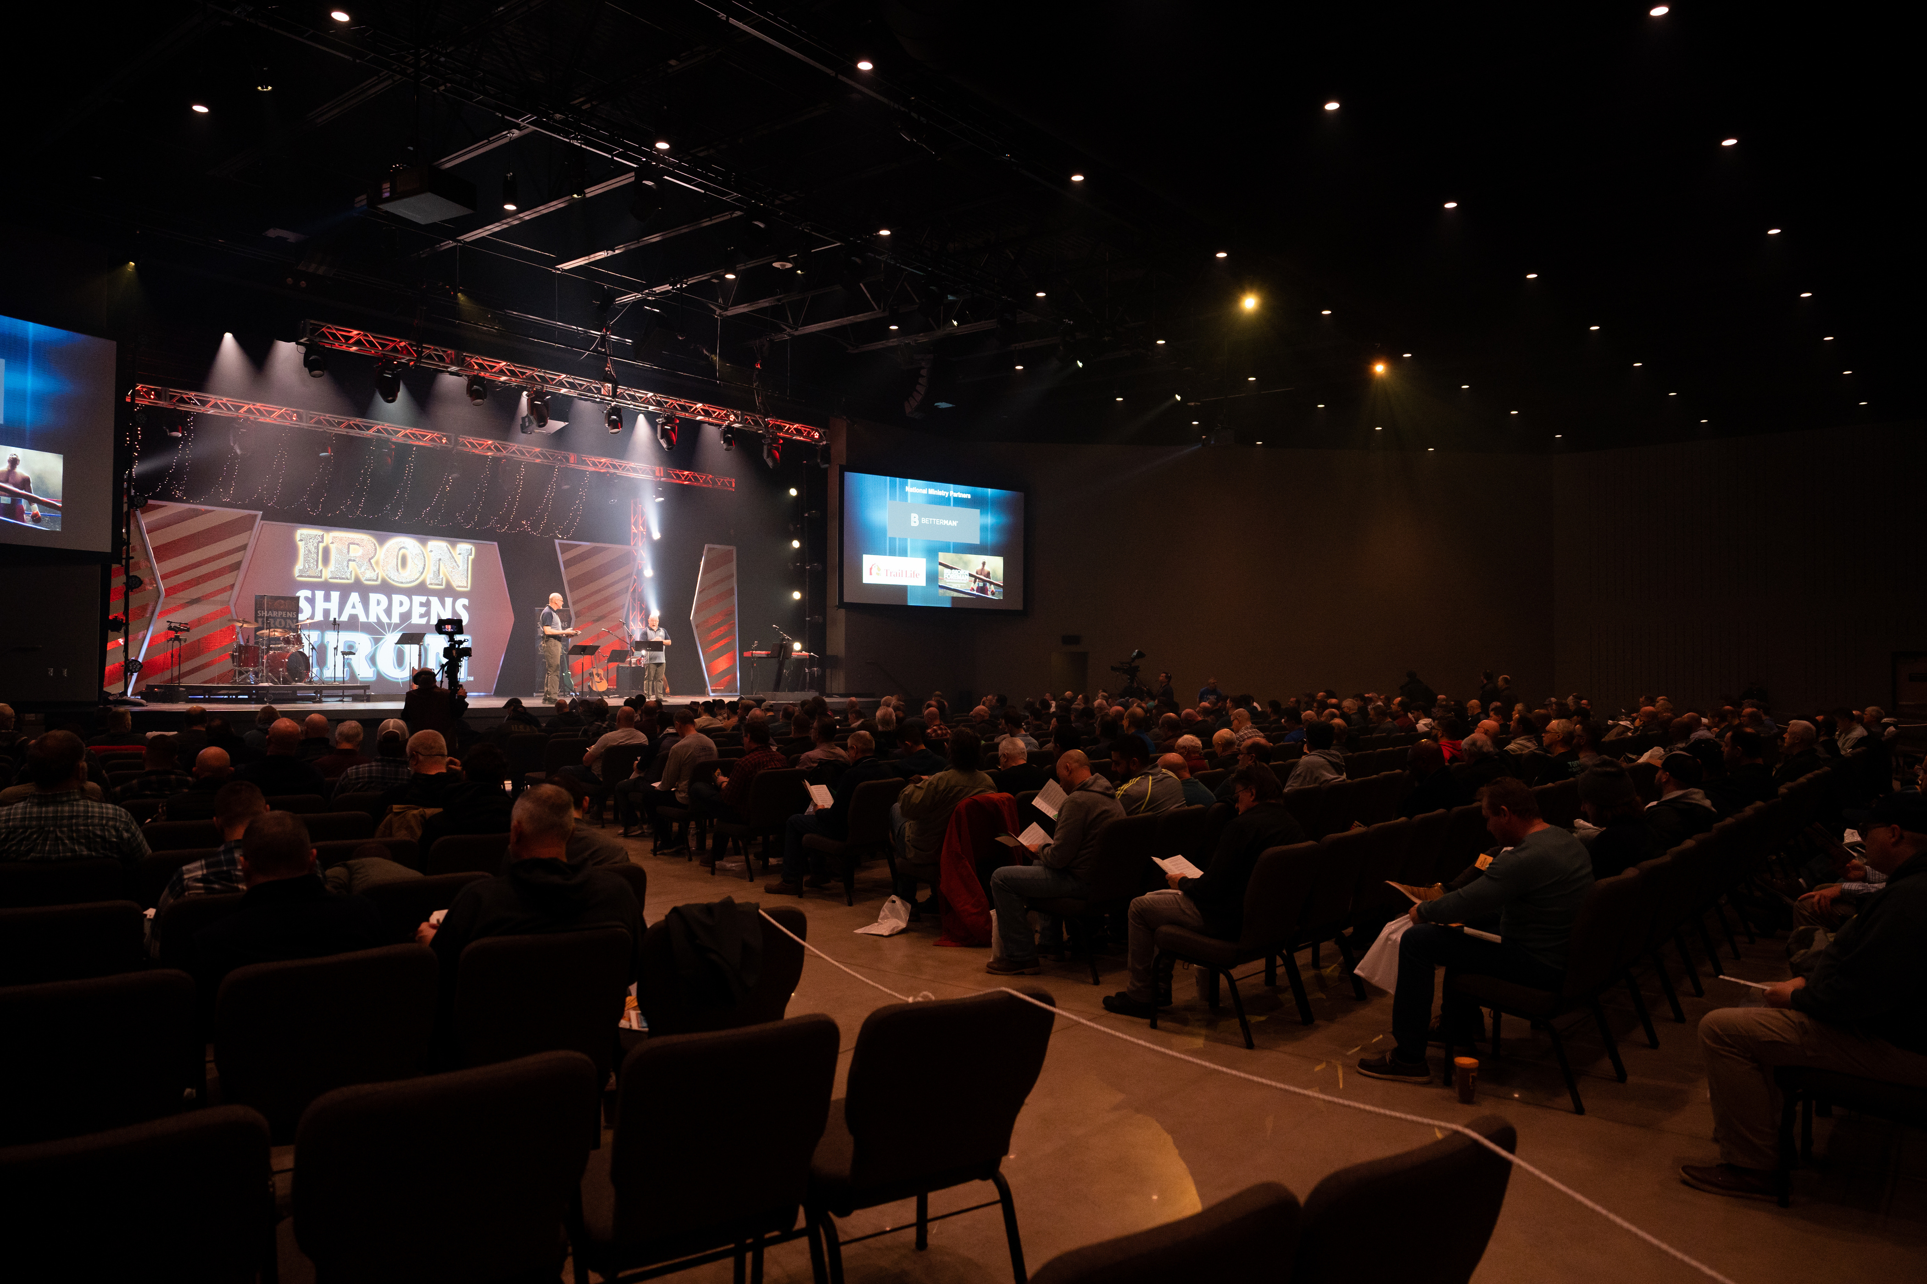

Rochester
Men’s
Equipping
Conference
Saturday, October 24th

Slide 2
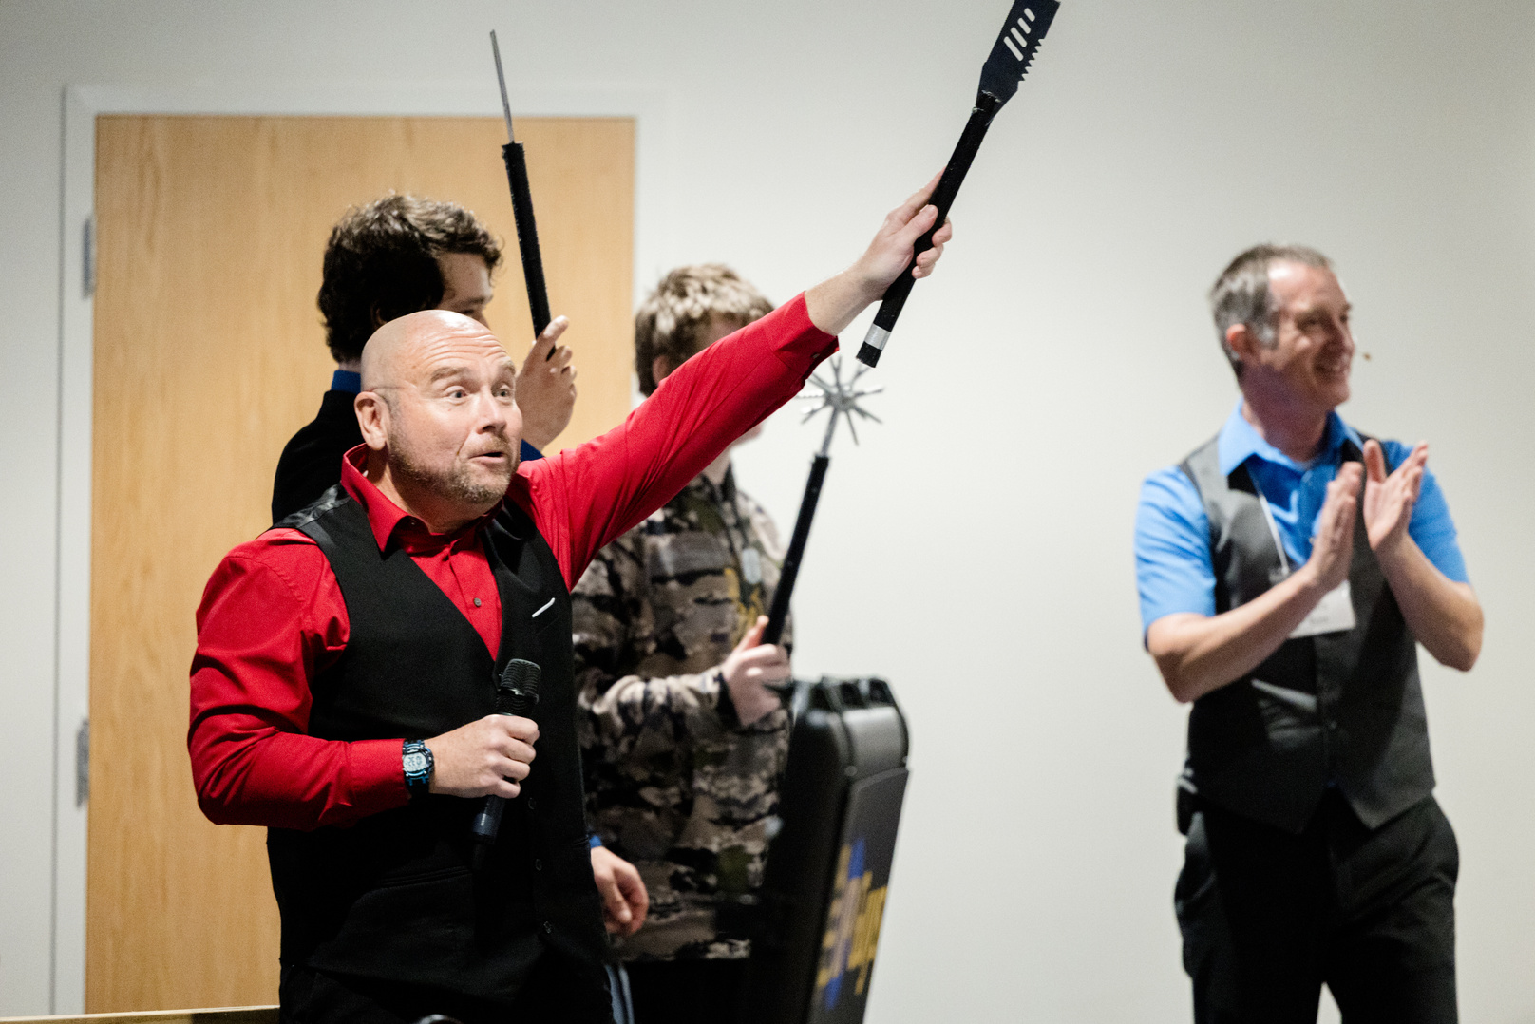
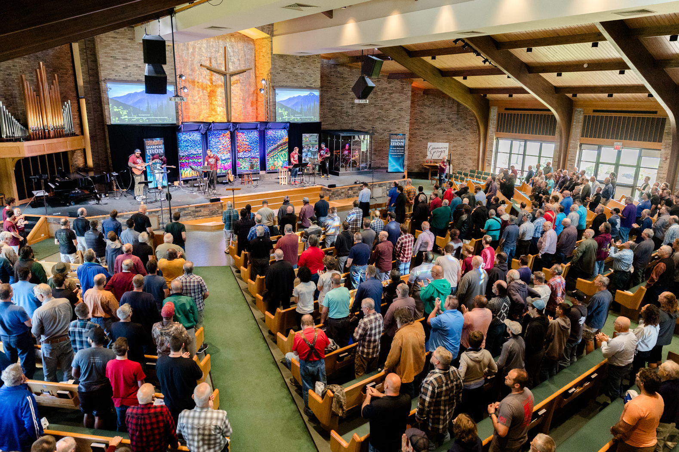
Men’s Equipping Conference
WORSHIP with hundreds of men from all over the region!
CHOOSE from 16 different equipping seminars
VISIT with expert presenters and exhibitors
EQUIP yourself with resources from local and national ministries

Slide 3
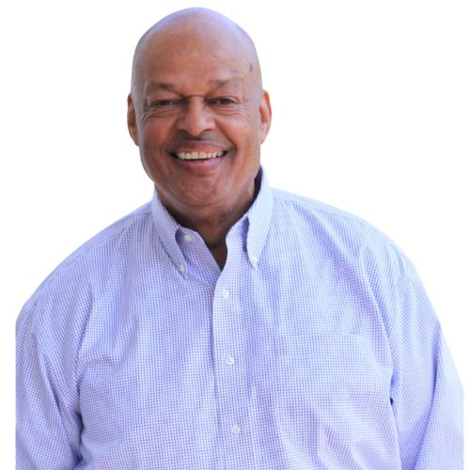
Keynote Speakers
Bill Paige is a gifted, passionate speaker whose broad appeal is anchored in a depth of life experience that includes 20 years of police and detective work in and around New York City metro area. In addition, Bill served 14 years as the associate chaplain at Children’s Village, working with emotionally disturbed boys in the city, as well as 18 years of senior leadership in Young Life, serving as Vice President of Field Ministries in the Eastern and Greater NY Divisions of Young Life.

Slide 4
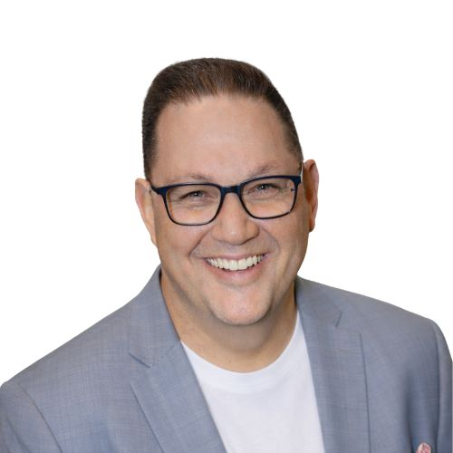
Keynote Speakers
Jason McGuire serves as the Executive Director of New York Families and its affiliated organization, New York Families Action. He is a passionate defender of Christian principles, including the sanctity of life, the sacredness of marriage, the centrality of religious freedom, and the need for a more just and merciful society. He believe these principles can be lived only when the hearts of men and women turn to God. Prior to his employment with New York Families, he served as Pastor of the Ingleside Christian Church in Naples, NY.

Slide 5
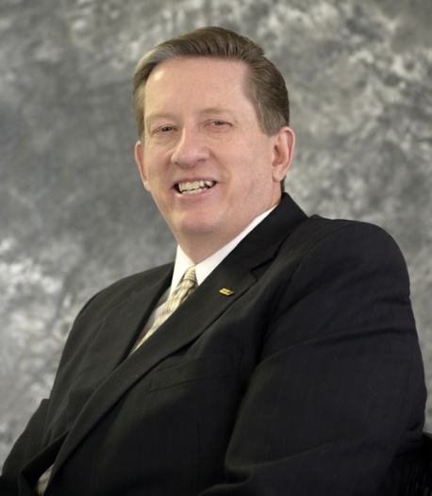

Men’s Equipping Conference
Saturday, October 24th
Pittsford Community Church
421 Marsh Rd, Pittsford, NY
Keynote Speakers
Joel Rissinger
Jay Cookingham
16 Seminar Options,
Resources from Dozens of Ministries,
& Hundreds of Men with One Mission!
Bill Paige
Jason McGuire
REGISTER WITH THE MEN OF THIS CHURCH FOR $52

Slide 6
Morning Seminars
1. Husbands Who Love Like Jesus
Joel Rissinger, Joel Rissinger Ministries, Storrs Mansfield, CT
2. Corn Flakes and Hammers
Dale Kinkade, Christian Service Brigade, Leavittsburg, OH
3. BATTLEPLAN: Strategies for Godly Sexuality
Jason Maybray, WNY Freedom Group, Hamburg, NY
4. Types and Telos: Growing in God’s Word
Jason Drapeau, Relationslips, West Seneca, NY

Slide 7
Morning Seminars
5. Unwounded: Healing the Mother and Father Wound
Jay Cookingham, Strategic Fathering Ministries, Hyde Park, NY
6. We’re in a War!
Bruce Plummer, Grace Road Church, Brockport, NY
7. Discovering Your Identity
Gavin Hill, Fellowship of Christian Athletes, Eden NY
For Emerging Men (ages 13-19)
8. Leaving Your Baggage at the Door
Bill Paige, former of Young Life, Montclair, NY

Slide 8
Afternoon Seminars
1. Honoring God’s Design (Sabbath Rest)
George Hoage, Family Life Ministry, Tonawanda, NY
2. Preparing for Disruptive Guest and Critical Incidents
Rick Capozzi, Survival Mindset, Franklin, PA
3. Look to the Toilet
Dale Kinkade, Christian Service Brigade, Leavittsburg, OH
*For Emerging AND Seasoned Men (ages 13-19 AND 55+)
4. More or Less – A Financial Checkup
Bob Glim, Pittsford Community Church, Pittsford, NY

Slide 9
Afternoon Seminars
5. The Crucified Leader: How to Lead Like Jesus
Joel Rissinger, Joel Rissinger Ministries, Storrs Mansfield, CT
6. Leading the Men of Today
Wayne Burroughs, Man in the Mirror, Alexander, NY
*For Pastors and Men’s Leaders
7. The Man’s Guide to Blended Families
Scott Haima, NCMM, Boston, NY
8. Mentoring Manhood in a Gender-Confused Culture
Jason McGuire, New York Families, Rochester, NY

Slide 10
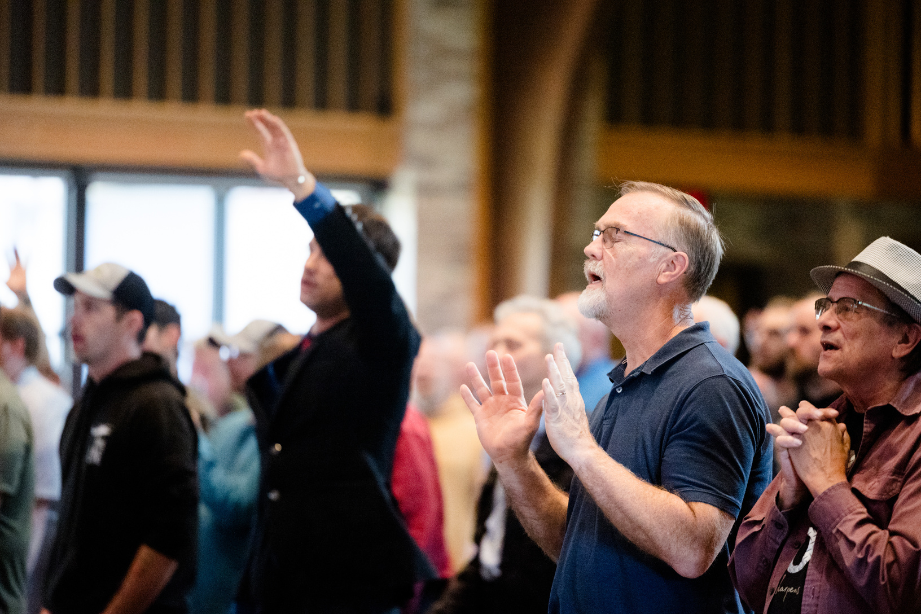
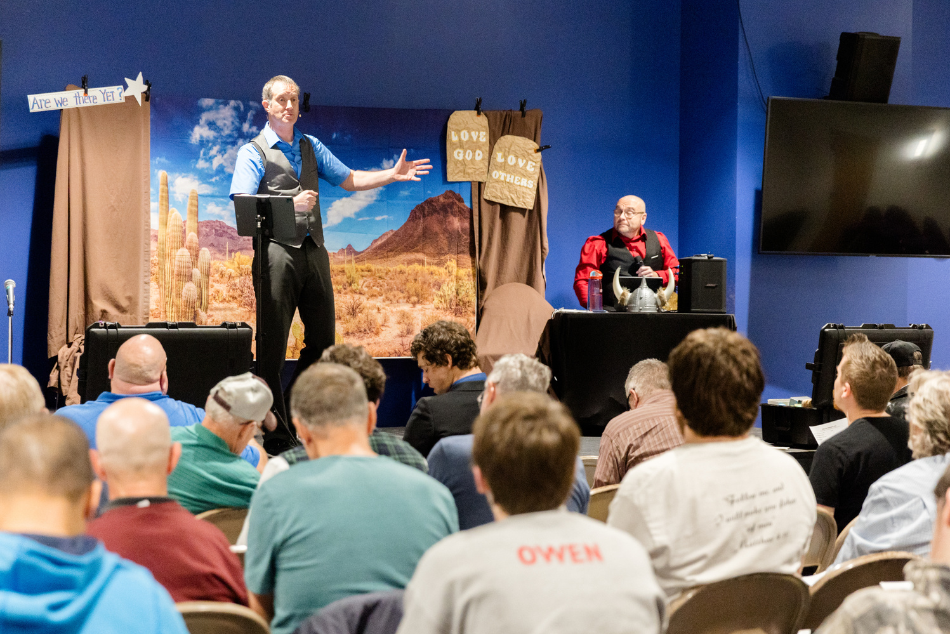
Men’s Equipping Conference
Saturday, October 24th
Pittsford Community Church
421 Marsh Rd, Pittsford, NY
Doors Open @ 7:30 am for Fellowship
Conference Begins @ 8:25
Conference Ends @ 4:00
RochesterISI.COM
REGISTER WITH THE MEN OF THIS CHURCH FOR $52

